Slide 1
Public Speaking: Tips and Tricks
ARANS
May 17, 2025
Josie Volovetz, MD PhD

Slide 2
Outline
Introduction
Goals
Preparation
Delivery
Challenges
Conclusions

Slide 3

Introduction
PGY6 neurosurgery resident
Cleveland Clinic Lerner College of Medicine
Research in brain tumors

Slide 4
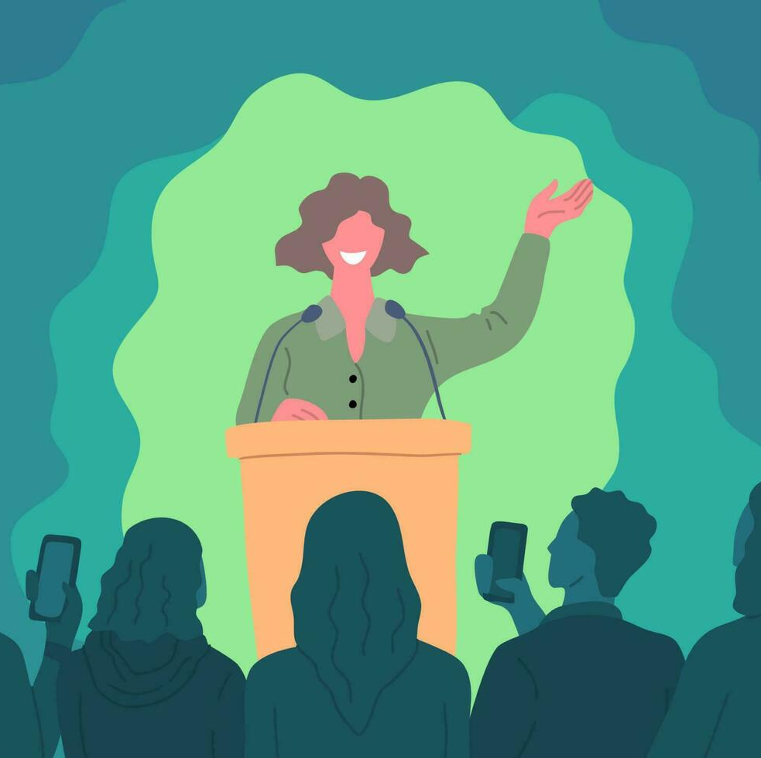
Goals
To help us all become more effective and successful at public speaking
What are goals of public speaking?
To communicate
To motivate
To educate
Career advancement

Slide 5

Preparation
Know your audience
Know your time allotment
Structure
Introduction
Body
Conclusion
Stories, analogies
Succinctness
Practice, practice, practice

Slide 6
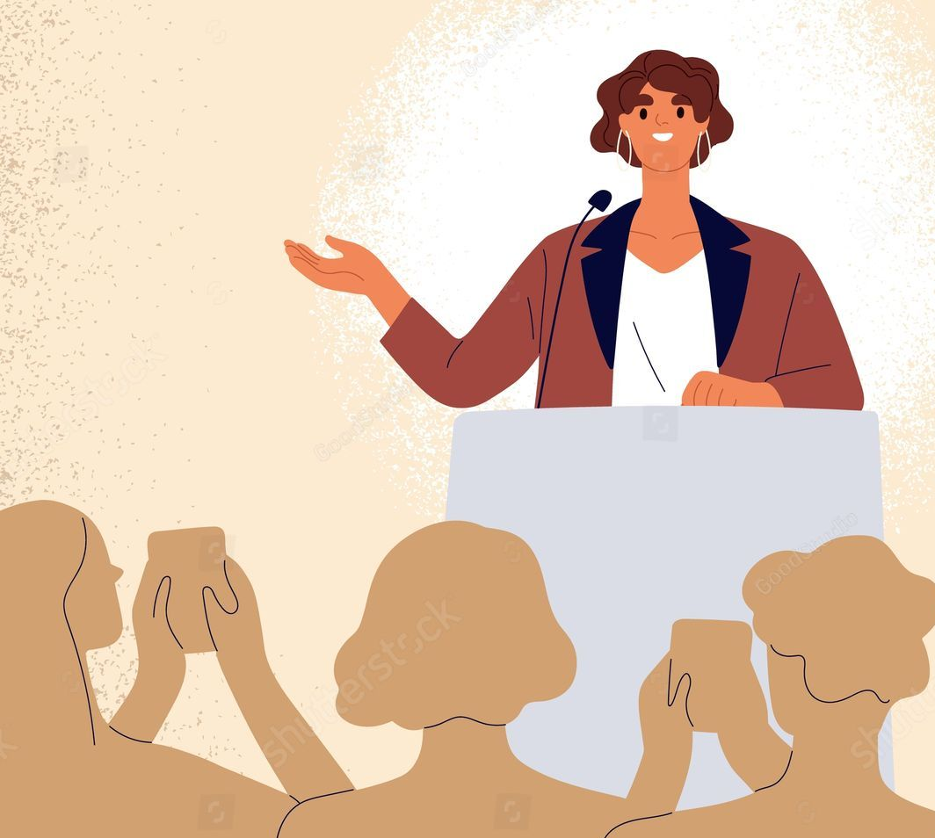
Delivery
Eye contact
Be aware of your hands and body language
Vary your tone and pace
Use technology
Slides, videos
Simplicity is key

Slide 7

Challenges
What are some challenges to effective public speaking?
Anxiety
Practice
Pauses
Staying on time
Practice
Timer
Maintaining attention
Audience involvement
Breaks
Stories

Slide 8
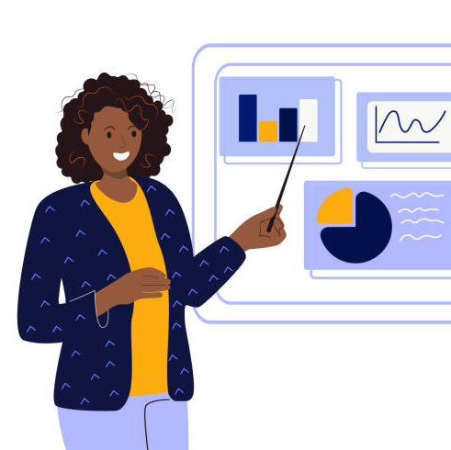
Conclusions
Public speaking is a valuable skill for communication, education, career advancement
Knowing your audience is key to an effective presentation
Practice will help with staying on time, sounding confident, and overcoming anxiety

Slide 9
Thank you! Questions?

