Slide 1

Putting Data to Work:
Enhance ACGME Case Log Analytics
05/17/2025 ARANS

Slide 2

Background & Disclosures
Co-Founder: Train-Track Analytics
Consultant: Globus Medical, Inc.
Assistant Professor of Neurological Surgery at Houston Methodist
Residency: UCLA 2021
Fellowship: Swedish 2022

Slide 3
Some Numbers
2024 (Neurosurgery)
2024 (All Surgical Programs)
104 Programs
211 Graduating Residents
~7000 Graduating Residents
1721 Cases per Resident (Average)
~1200 Cases per Resident (Average)
3.5 Minutes/Case
3.5 Minutes/Case
Per Resident:
6024 Minutes or 100.4 Hours
4.2 Days
Per National Class:
29,400,000 Minutes
490,000 Hours
20,417 Days
56 Years
Per National Class:
1,271,064 Minutes or 21,184 Hours
883 Days or 2.42 Years
At $90,000/year = $5,034,247

Slide 4
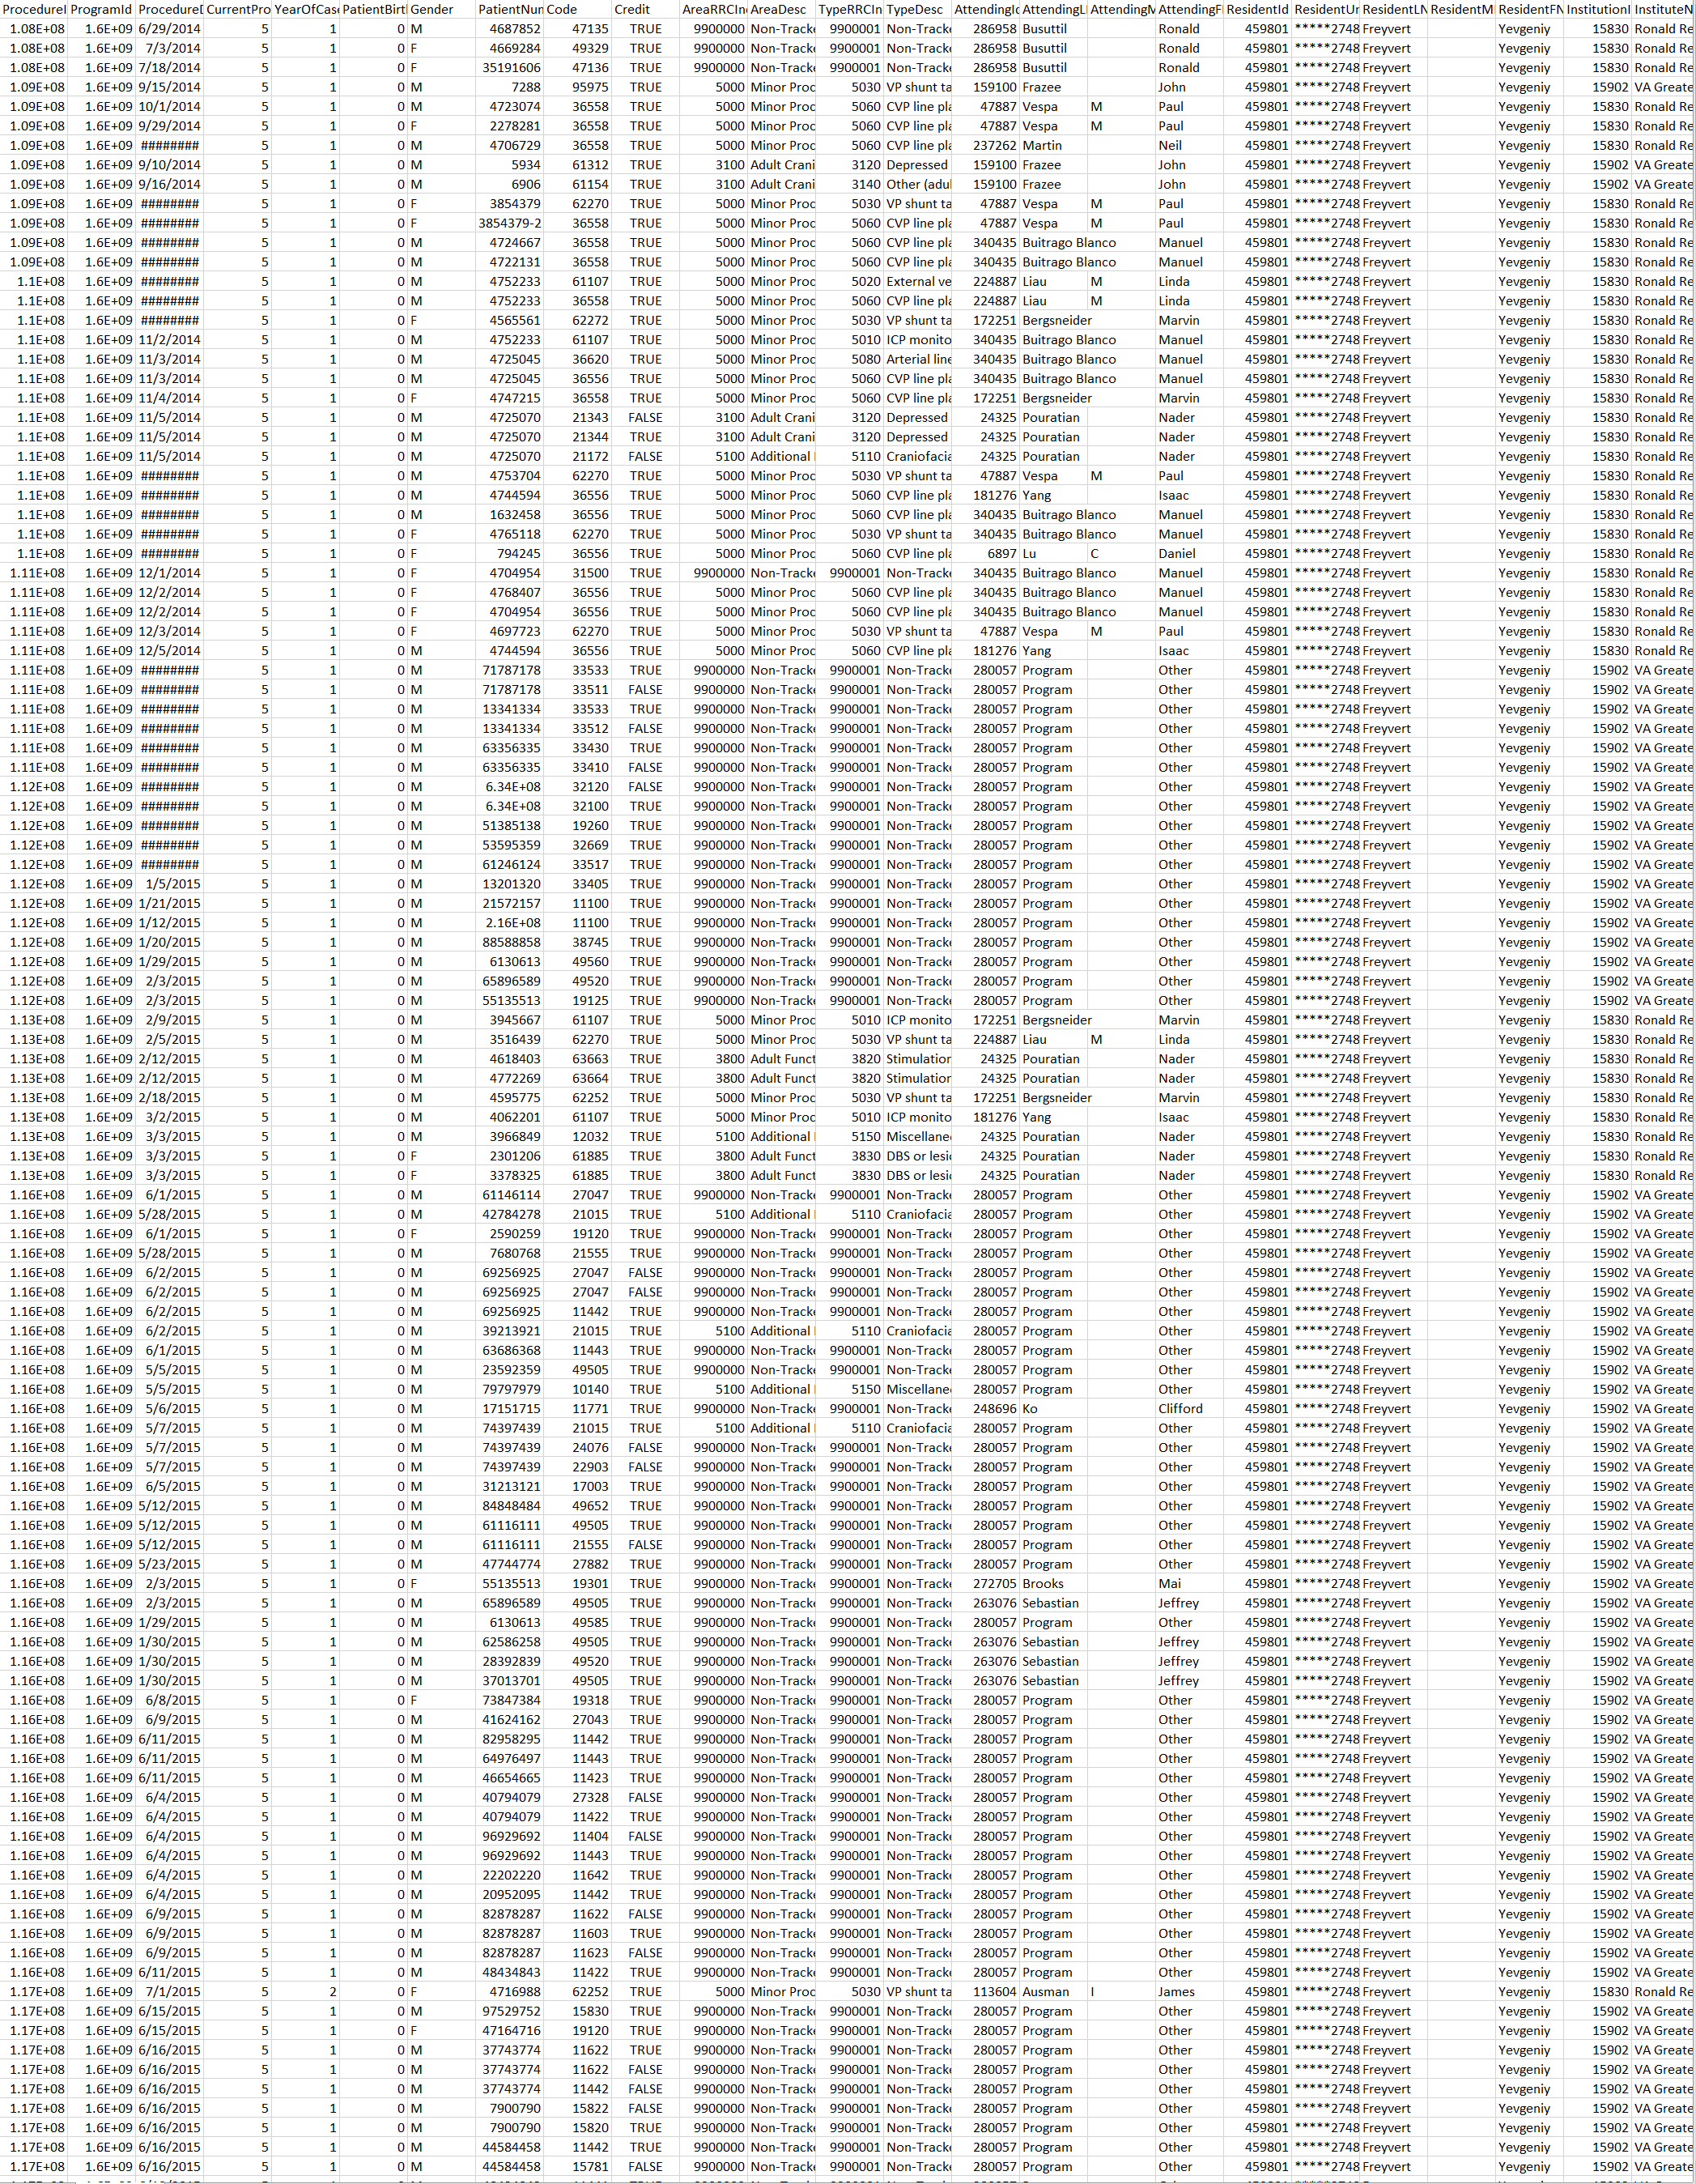
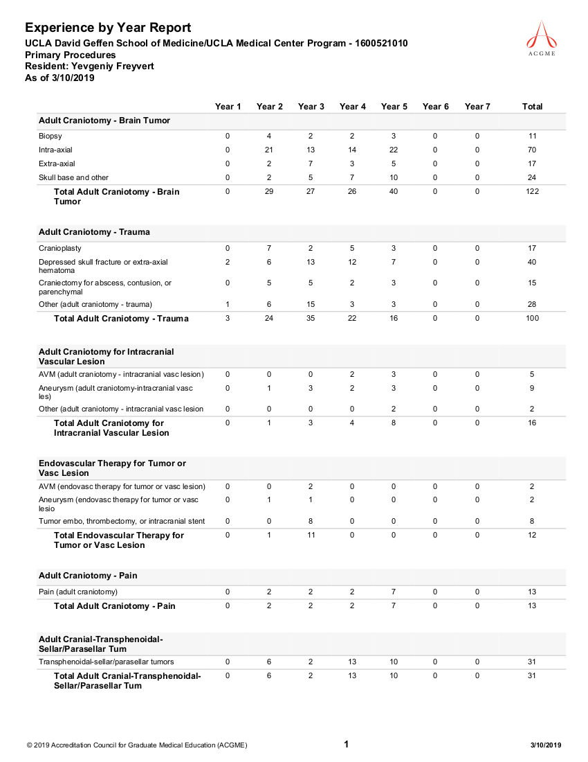
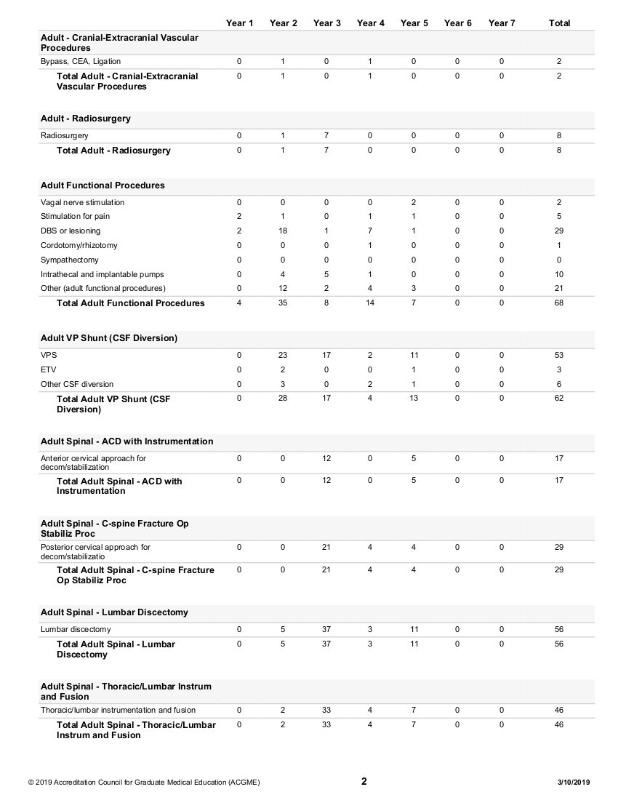
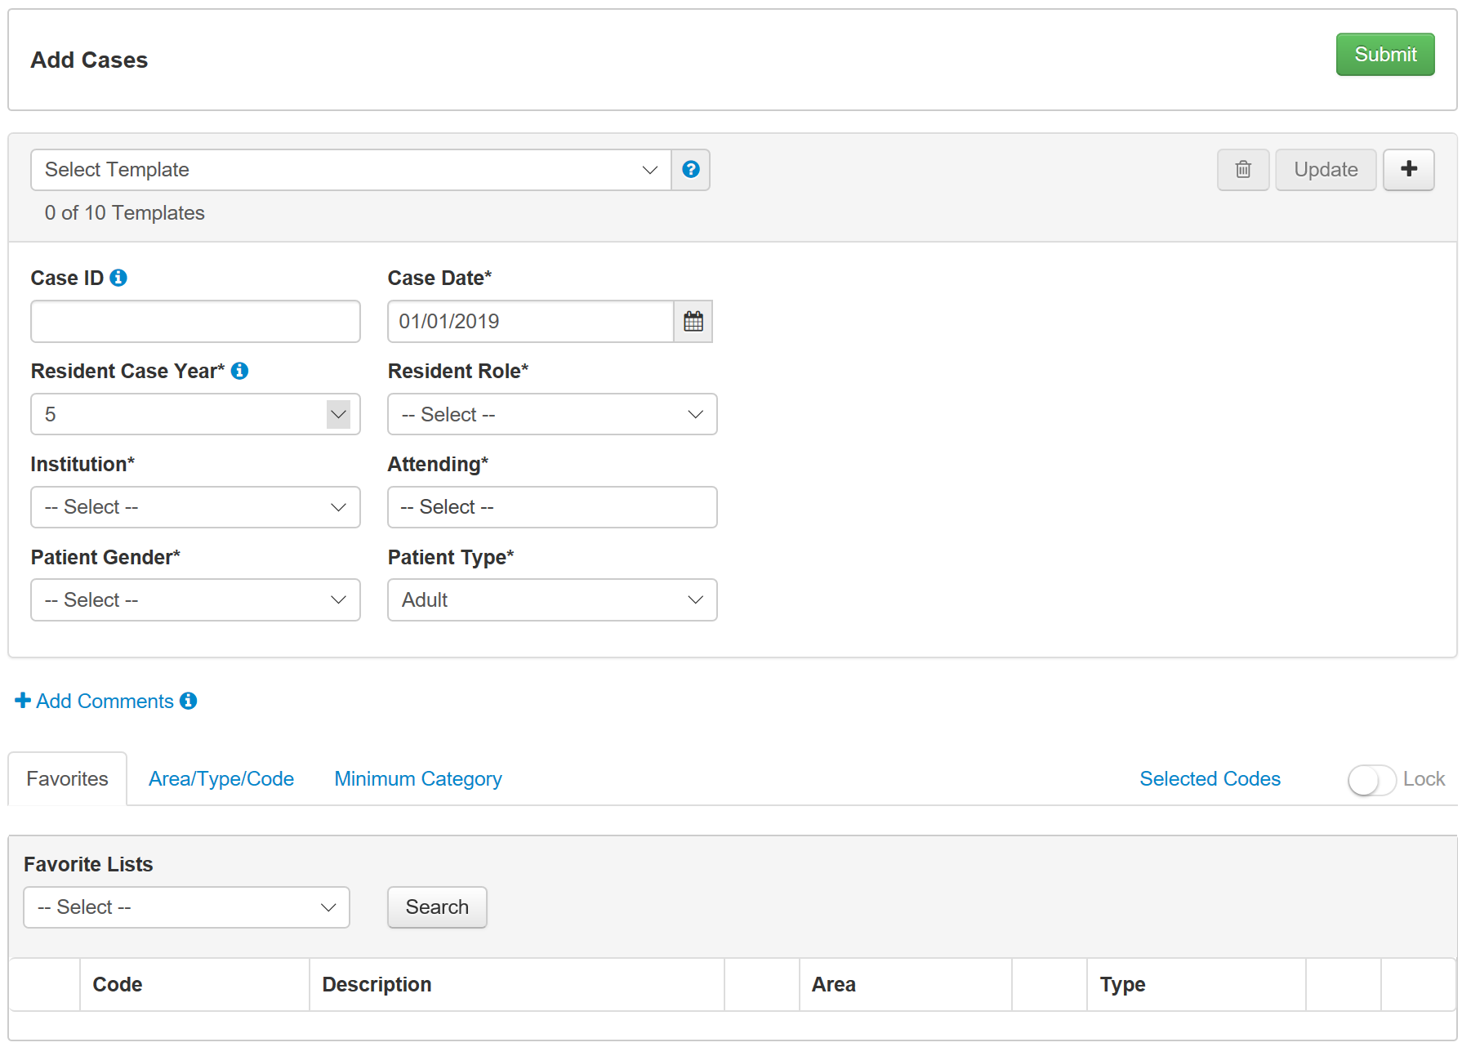
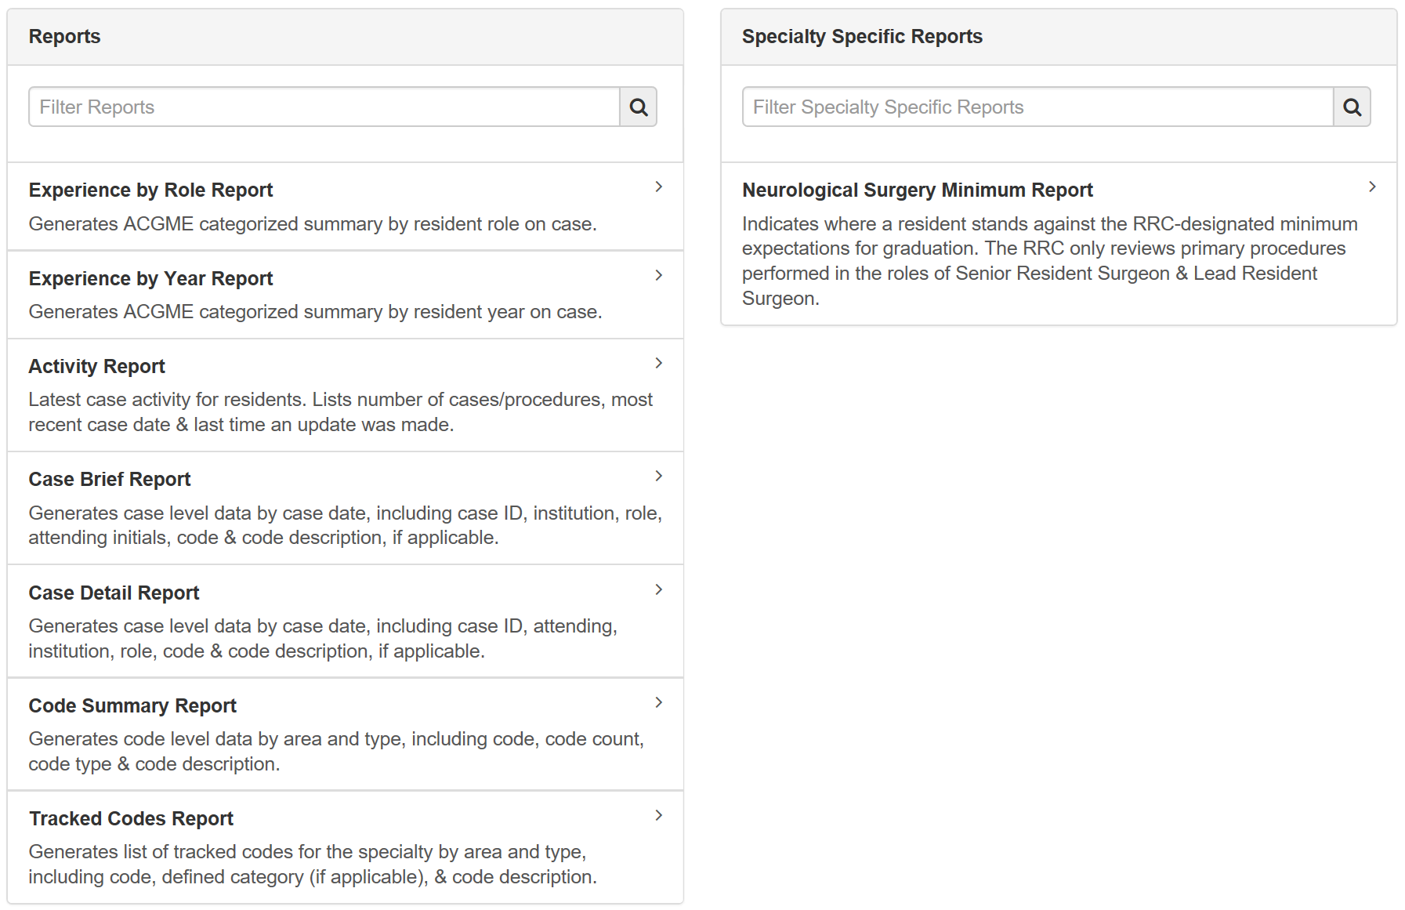
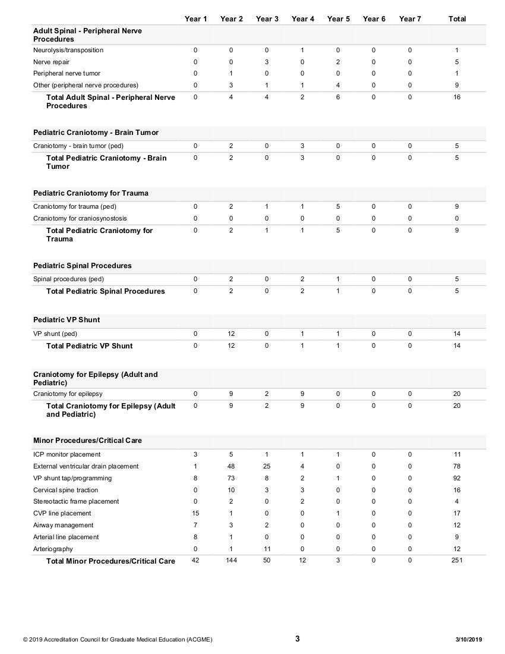
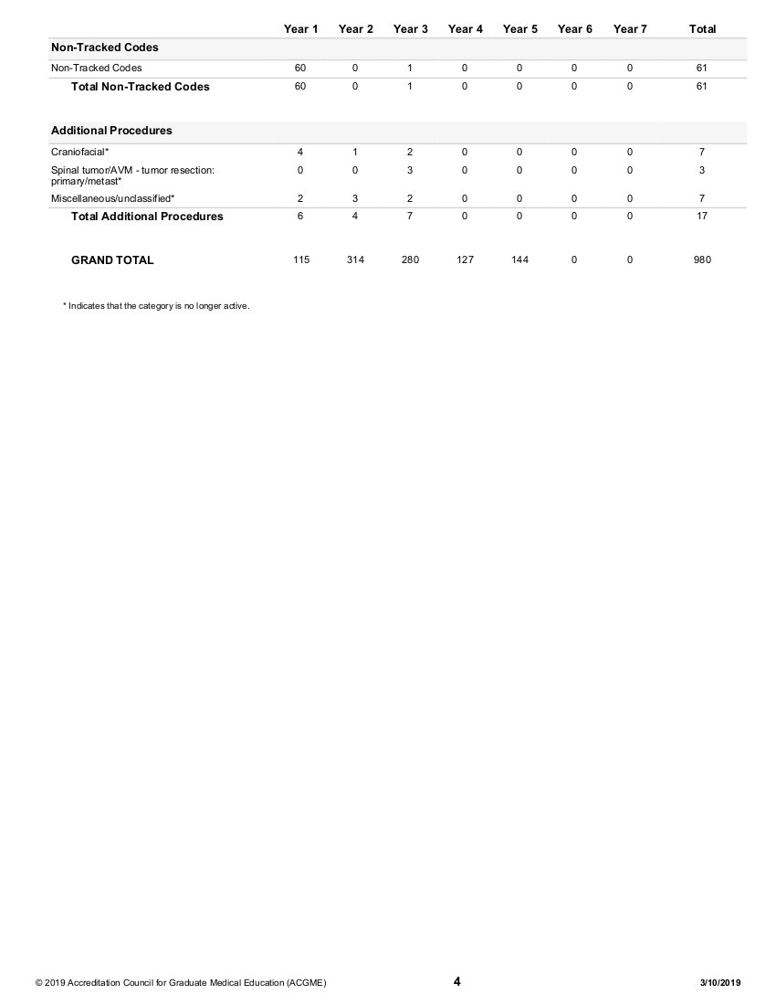
Context
Neurosurgical operative education is minimally data-driven at present.
ACGME provides a reliable
case logging system.
User interface & function are limited.
Potential for more efficient and informative utilization of collected data.

Slide 5
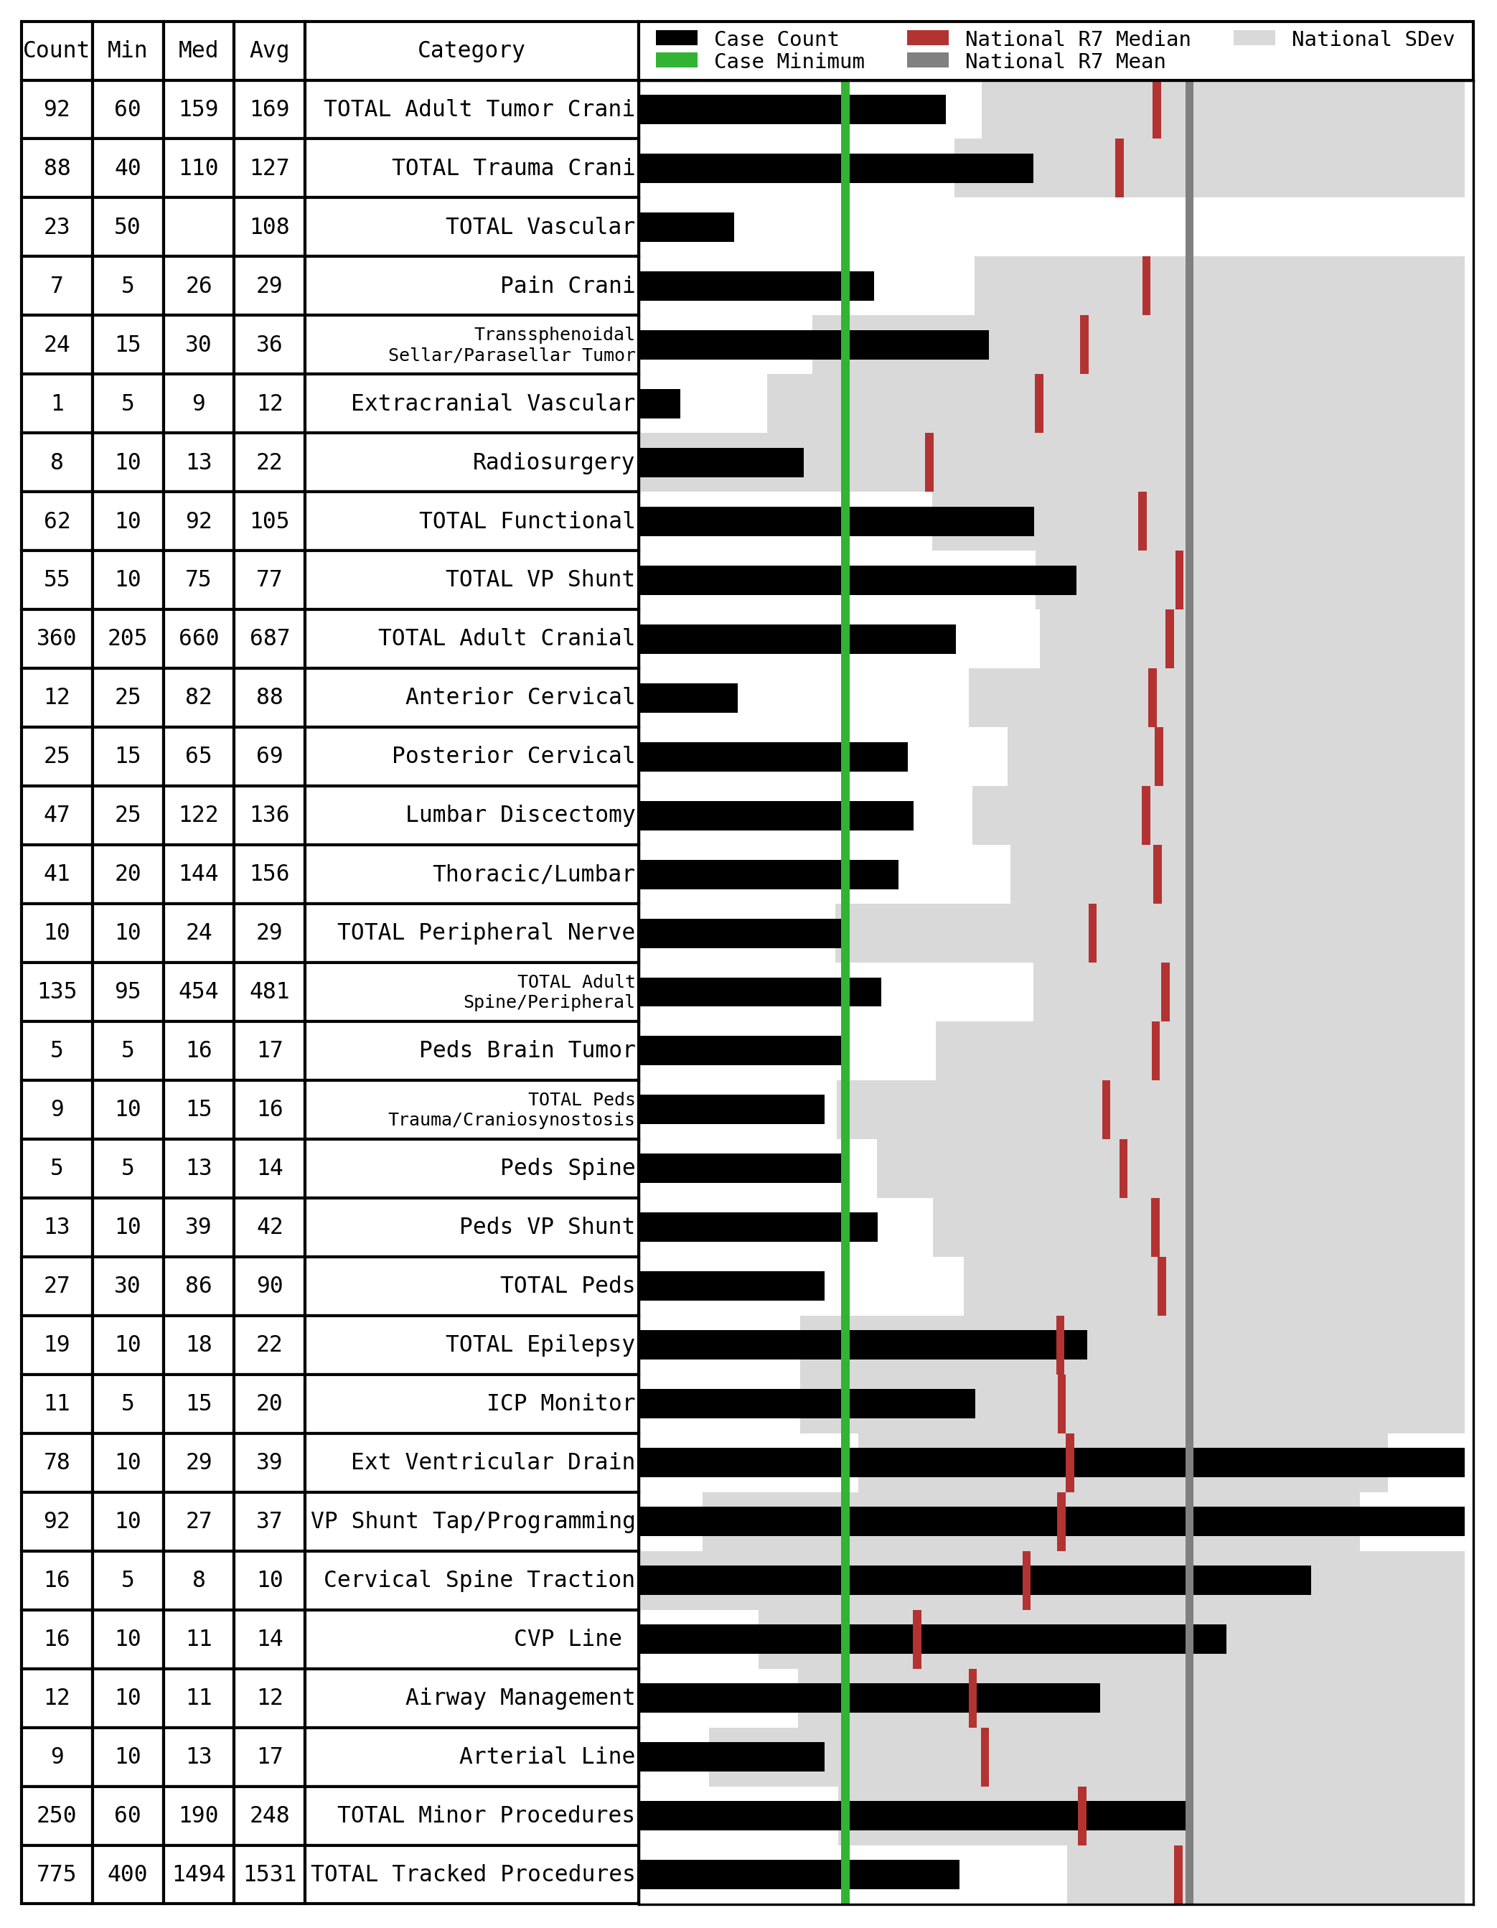
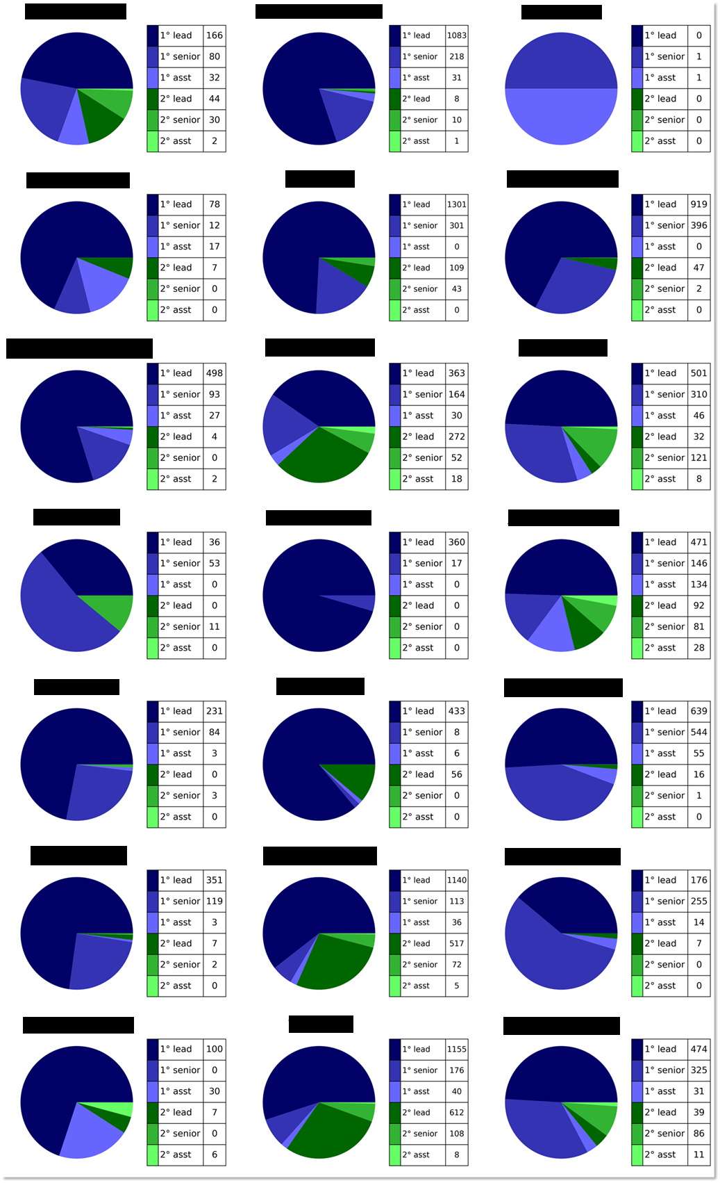
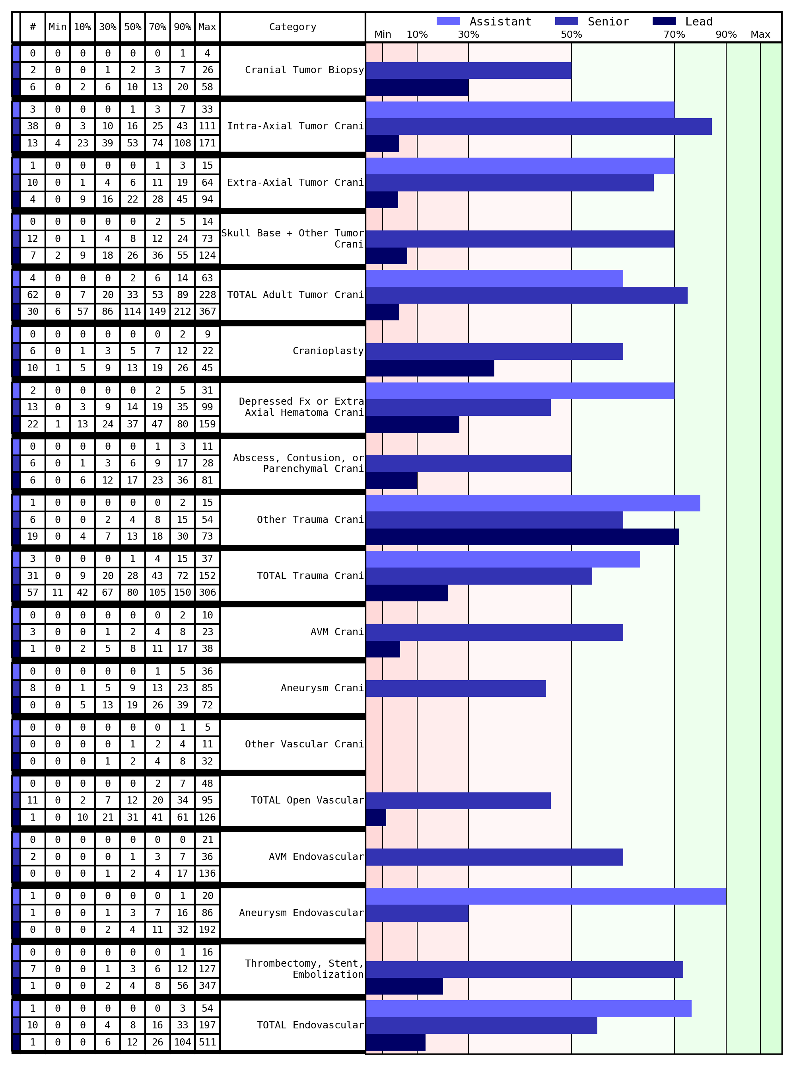
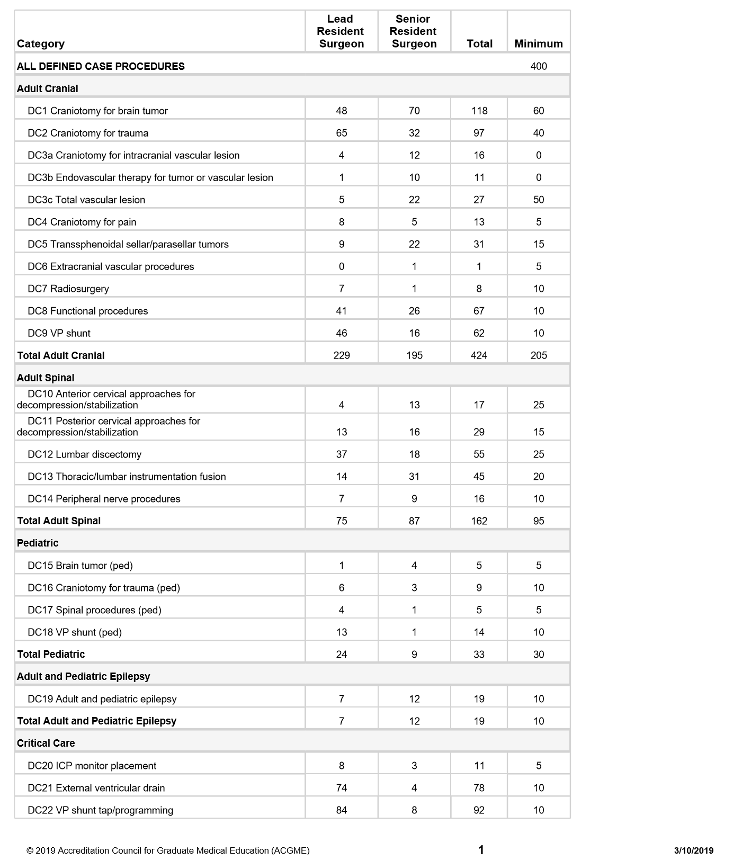
Process
Residency director/coordinator manually retrieve minimum report for each resident.
Residency director/coordinator retrieve single file containing raw data for all residents.
Manual comparison performed for each category.
Software automatically generates report integrating national data and minimums.
Manual comparison to national statistics.
Manual comparison to prior and current residents.
Current Workflow
Software- Assisted

Slide 6
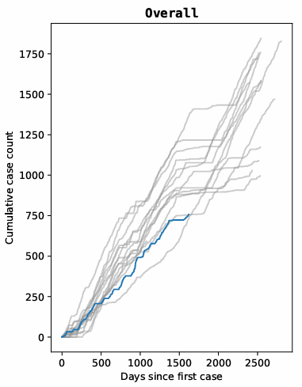
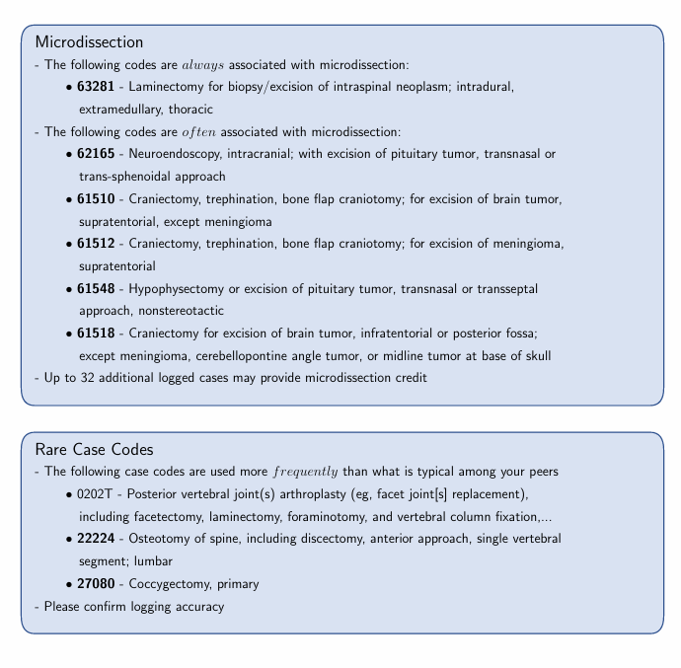
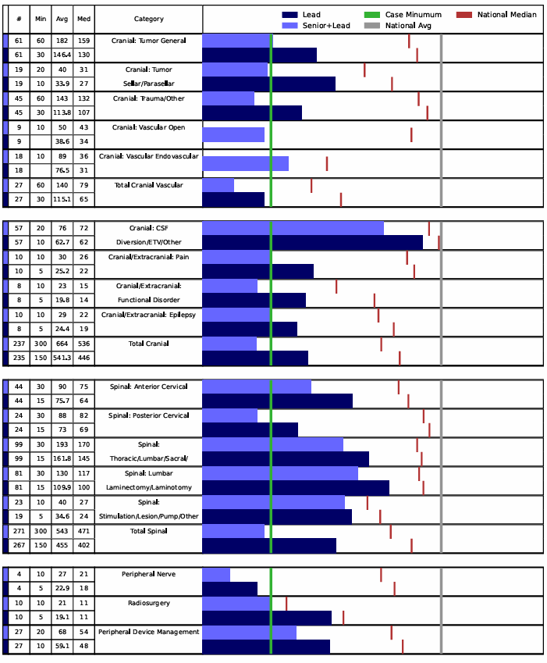
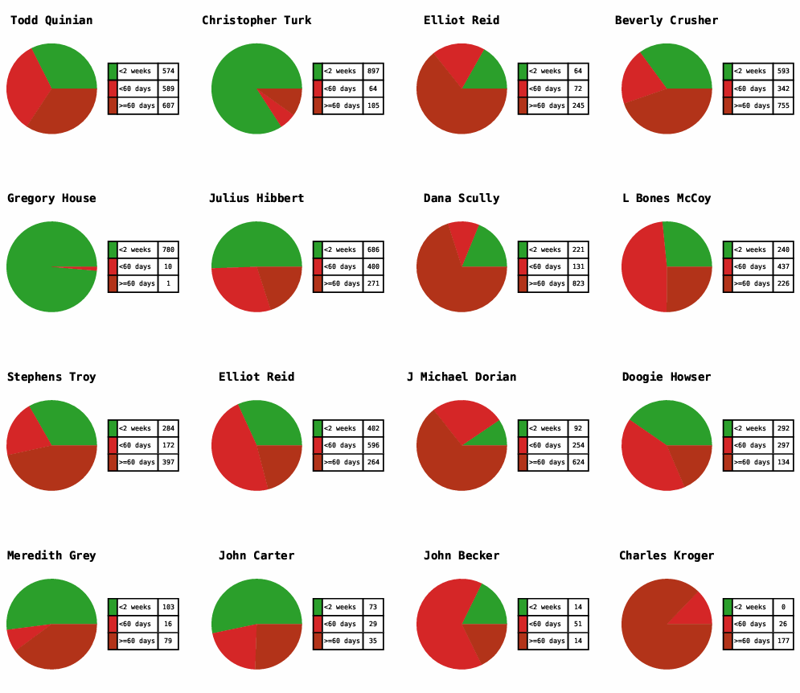
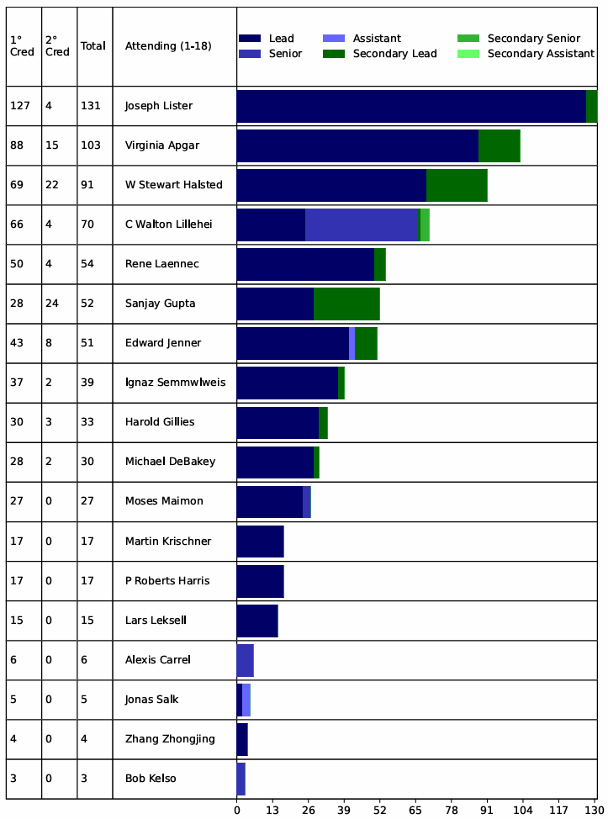
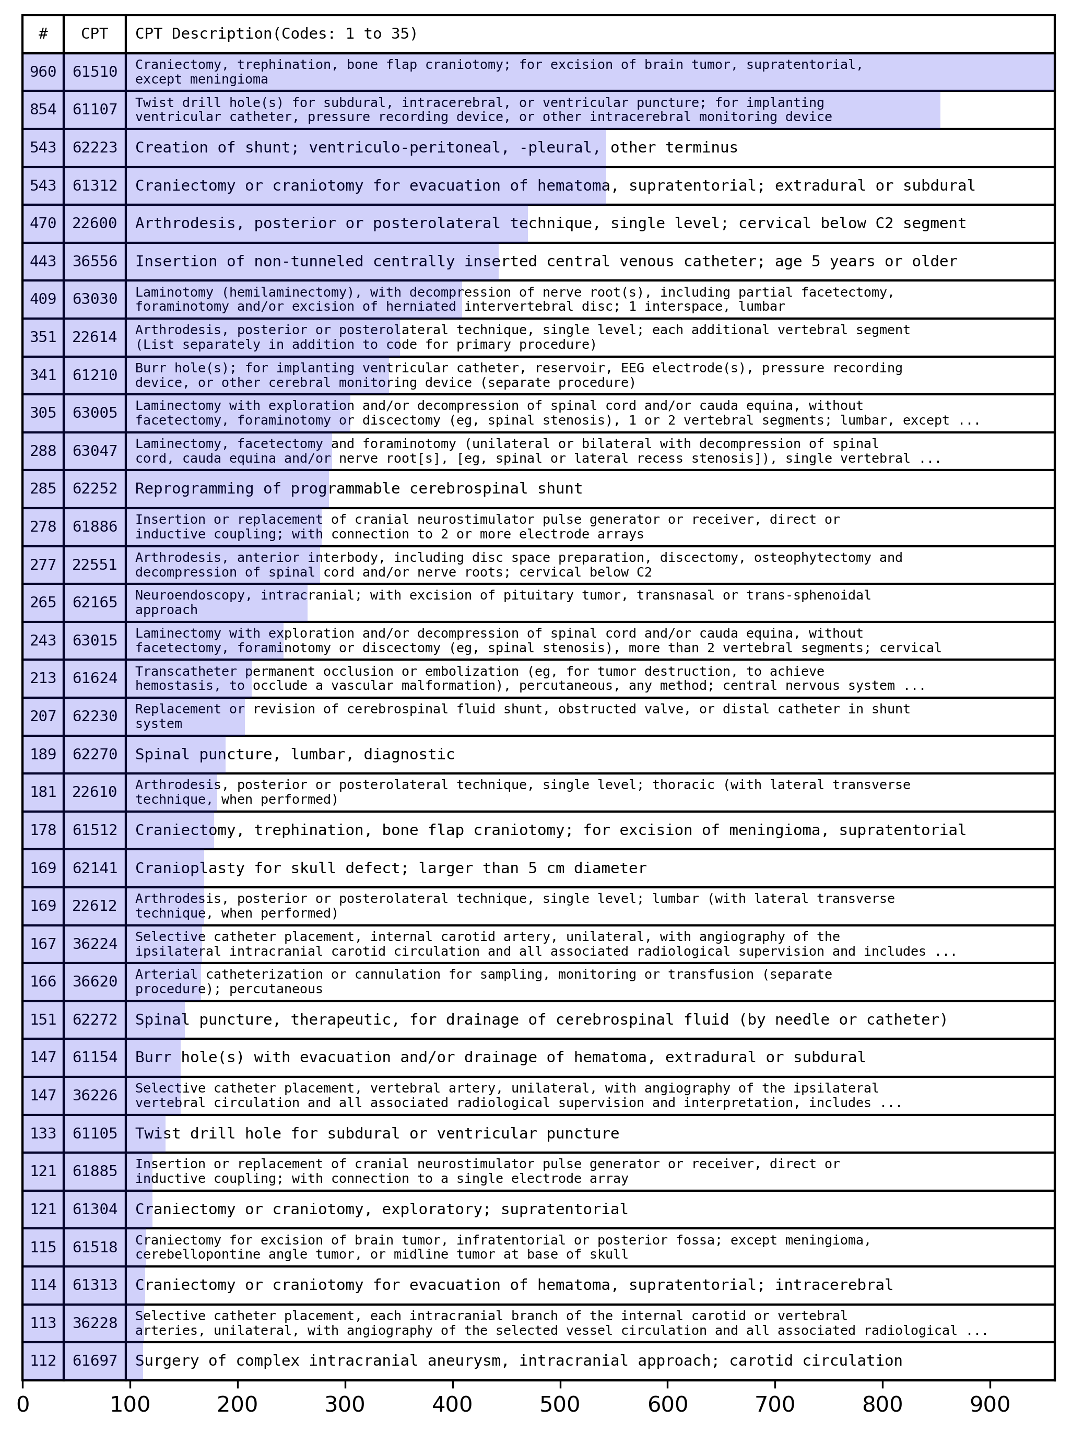
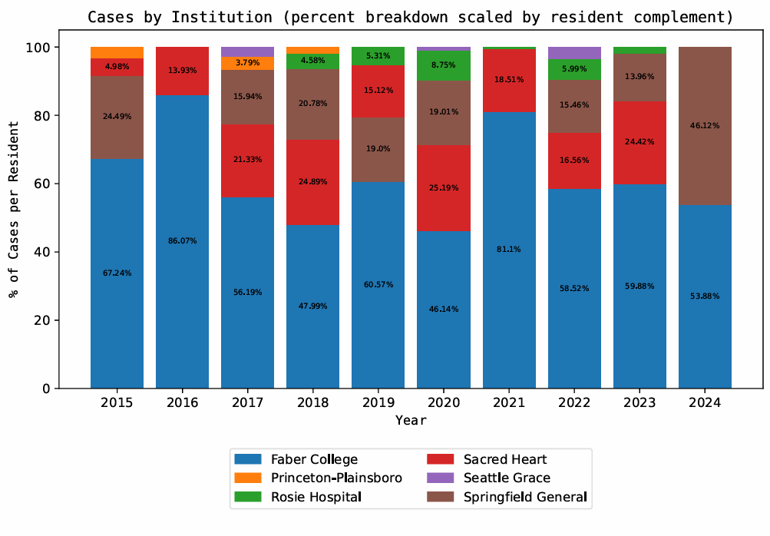
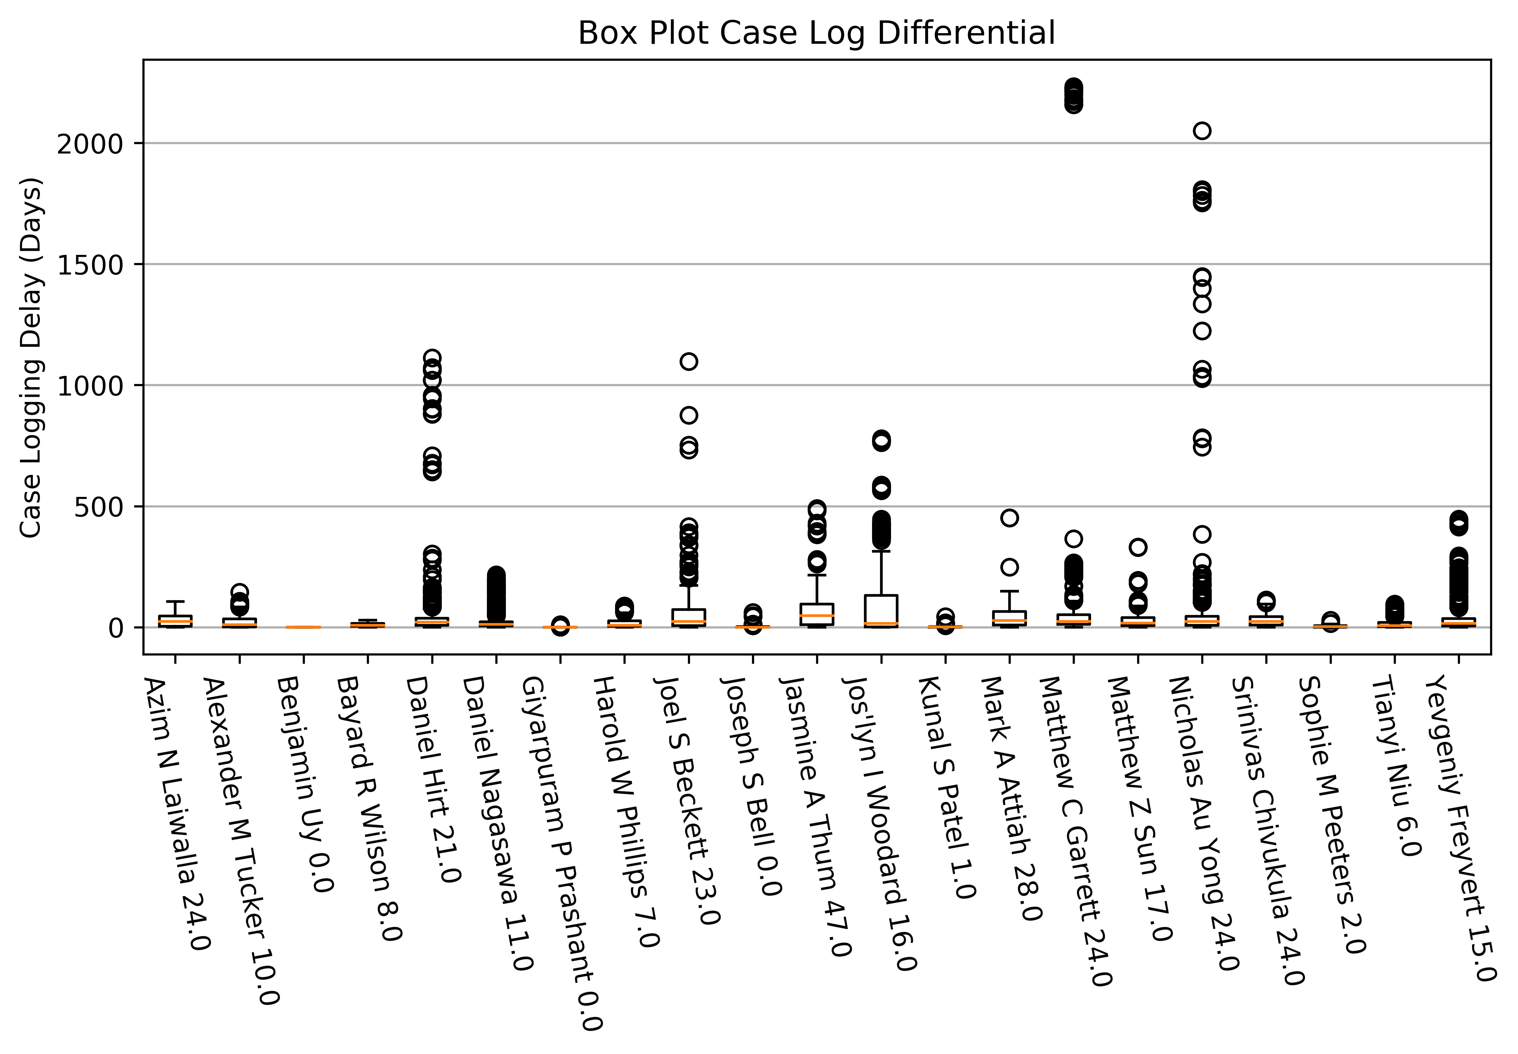
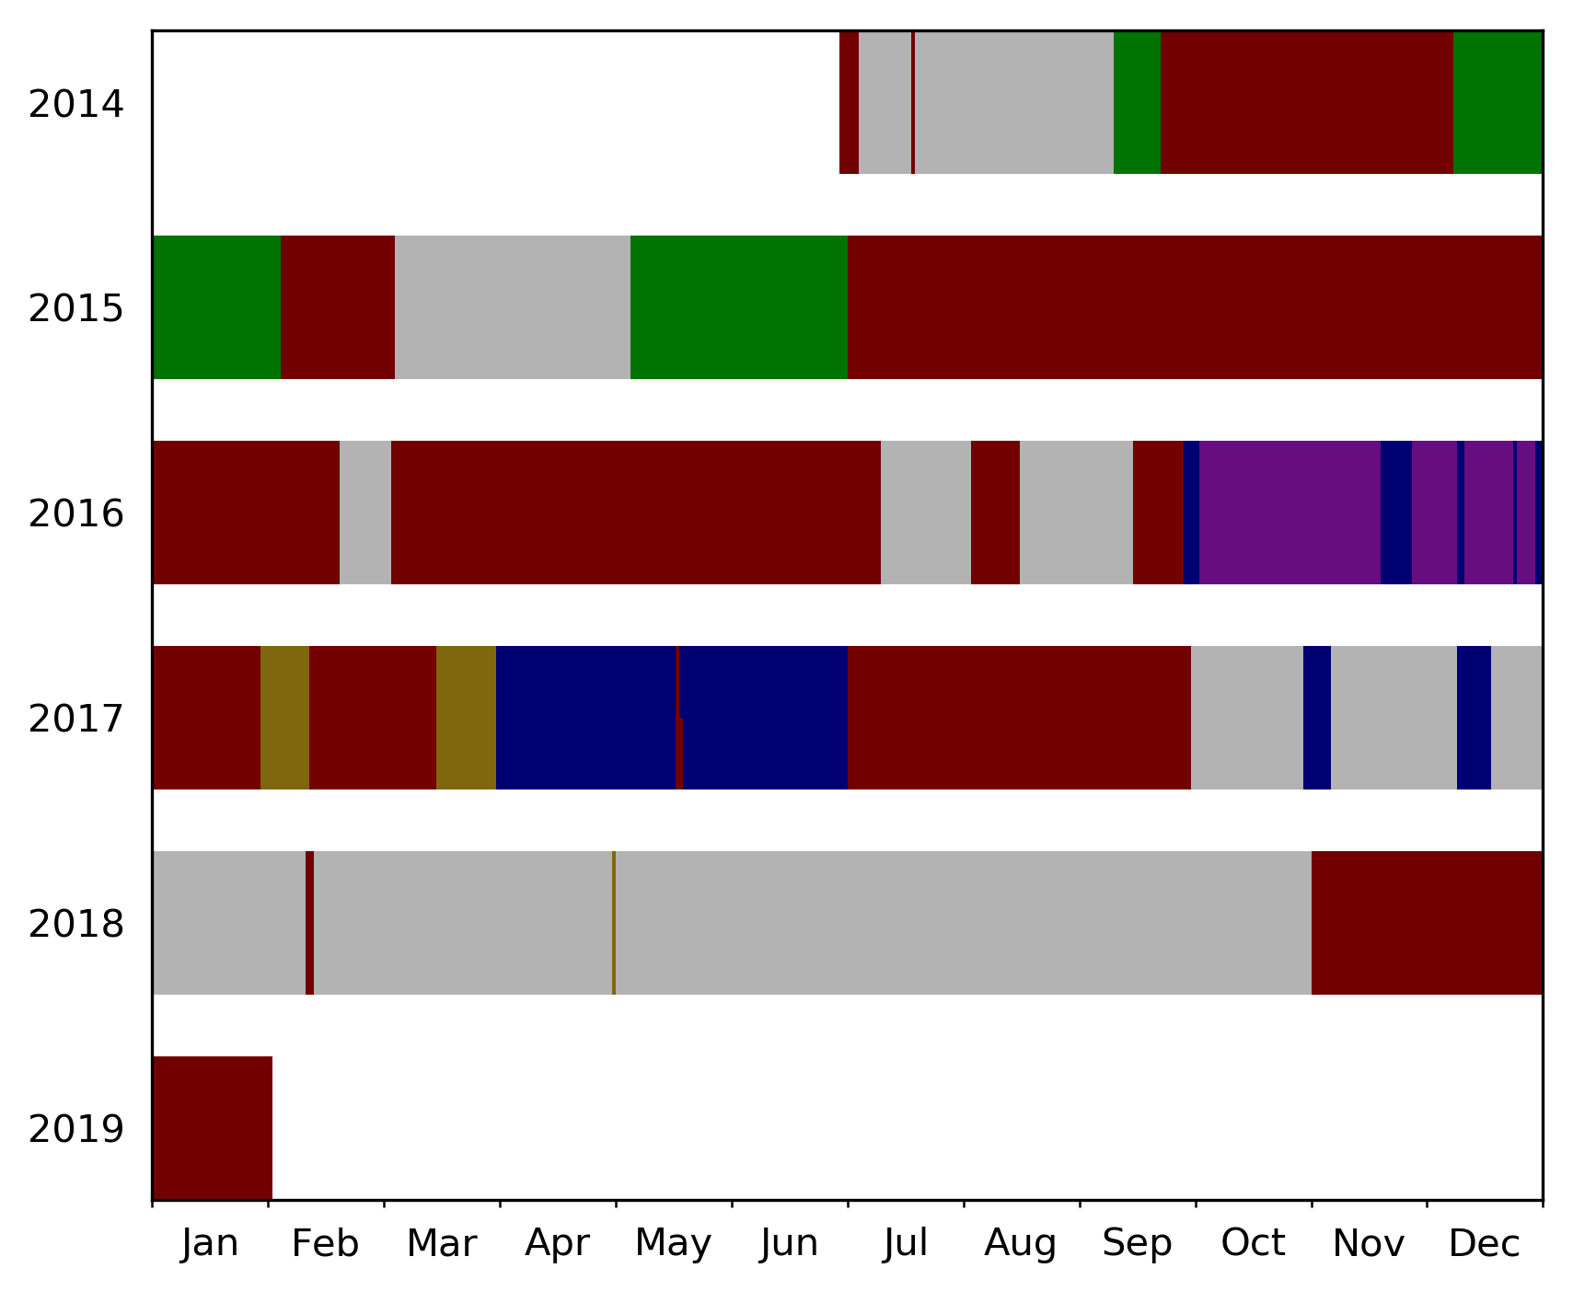
Capabilities
National
Specialty
Legacy system provides only resident-level data.
Residency
Faculty
Automation enables higher levels of analysis.
Attending
Vast flexibility and customization
Class
Resident
Clinical
Site
Enforce increased logging integrity.
Automated insights

Slide 7
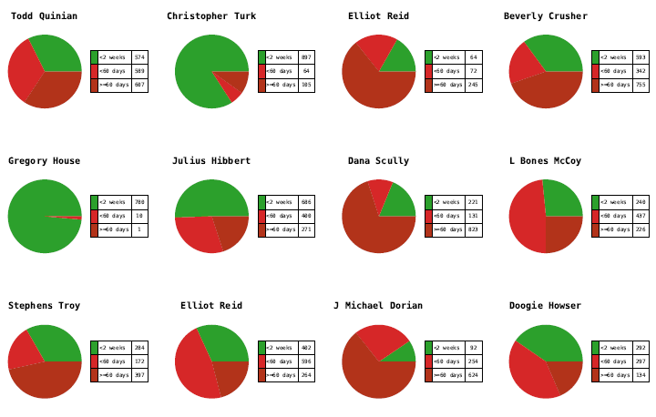
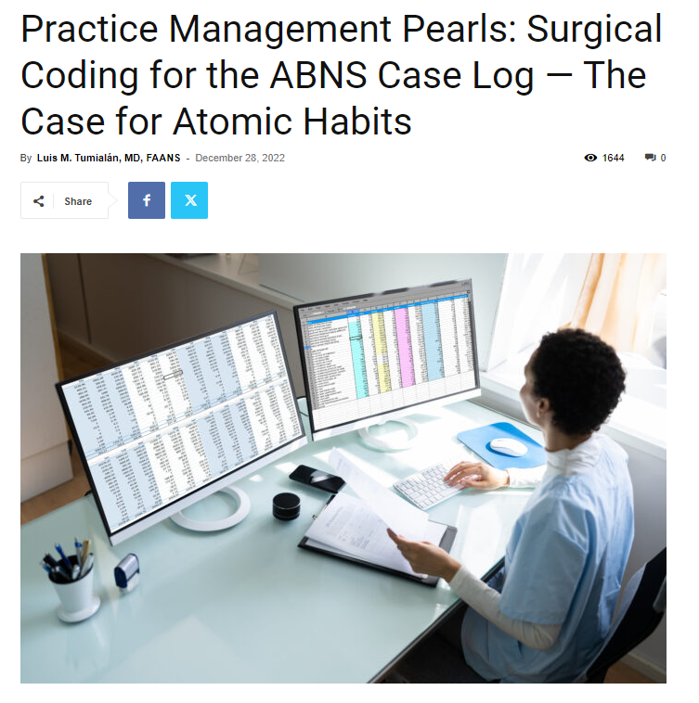
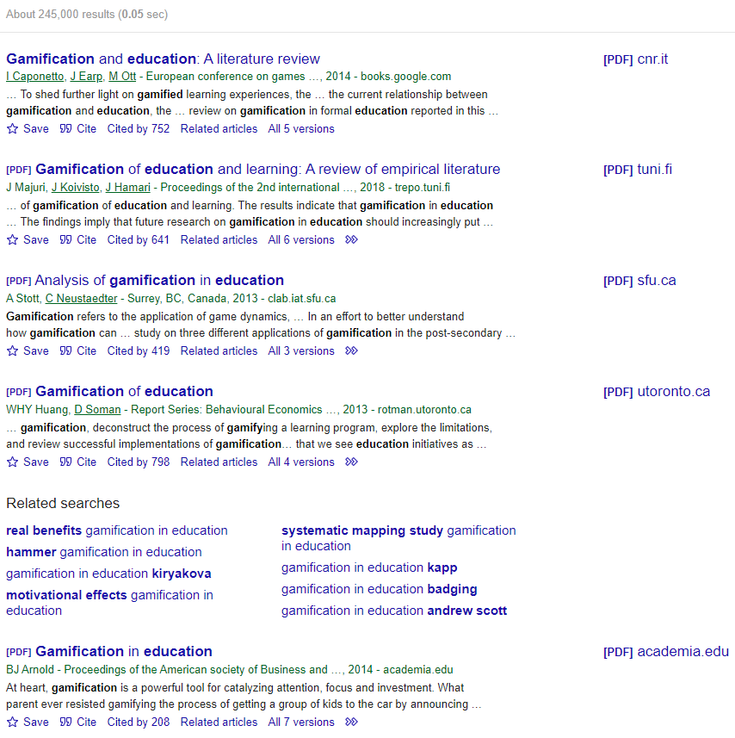
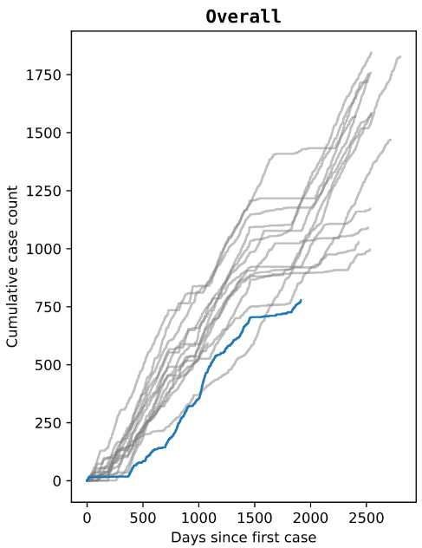

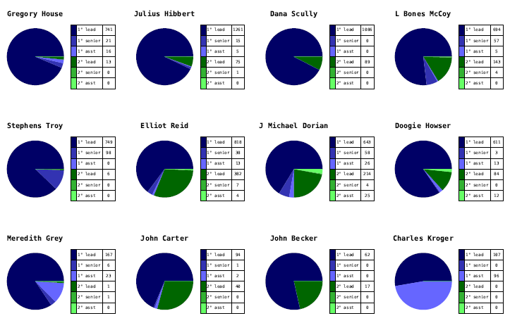
Why?
Implementation of case analytics in surgical residency education, a five-year retrospective
Time Savings
Trends in Neurosurgical Residency Operative Experience – a Multicenter Study
Logging Accuracy
Does Early Operative Experience in Neurosurgery Influence Career Choice?
Resident Education
Clip or Coil? What are the Trends in US Neurosurgical Resident Vascular Experience?
Resident Motivation
Program Management
Are Academic Programs Slower or Faster to Adopt Surgical Advances? Resident Exposure to Artificial Disc Replacement
Research Potential
Regional Variations in Neurosurgical Residency Operative Experience

Slide 8

TT nalytics
Inquiries
traintrackanalytics@gmail.com
(832) 378-7605

