Slide 1

Residency Match Updates for ARANS
Lola B. Chambless, MD
Program Director
Vanderbilt University Dept of Neurosurgery
Chair
SNS Medical Student Committee

Slide 2
Today’s Discussion
Key SNS Policies
Best Practices
Pitfalls to Avoid
How to Stay Updated

Slide 3

What is the ideal state?
Best candidates are matched
Good fit between program and residents
Low rates of attrition
Low cost/stress to applicants and programs

Slide 4
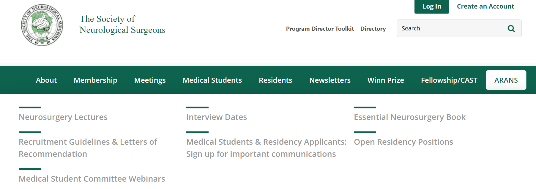
(website screen shot)

Slide 5
SNS Recruitment Guidelines
Number of Acting Internships
Standardized Letters of Evaluation/Recommendation
Preference Signaling
Standardized Interview Release Dates
Virtual vs In person interview policy
Campus Visits

Slide 6
Number of Acting Internships
Guidance: 1 home, 1-2 aways
2-3 aways if no home program
Why? Equity, cost, burnout, need for well rounded education
Key Points:
Make sure your students are aware
Make sure residents/faculty are providing good advice
If someone realizes they need to drop an extra rotation, help them do so and do not penalize them in the application process

Slide 7
Standardized Letters
Guidance: Use home SLOE, 1-2 Away SLORS, 1-2 any style
Why? Reduce bias, improve objective measurement of important skills, improve utility of LORs
Key Points:
Encourage faculty to use these!
Can be written by a pair/panel (especially home SLOE)
Help students request these during away rotations
Develop a system for recording resident comments
Craft statement about medical school exposure to reuse
No changes to template this year

Slide 8
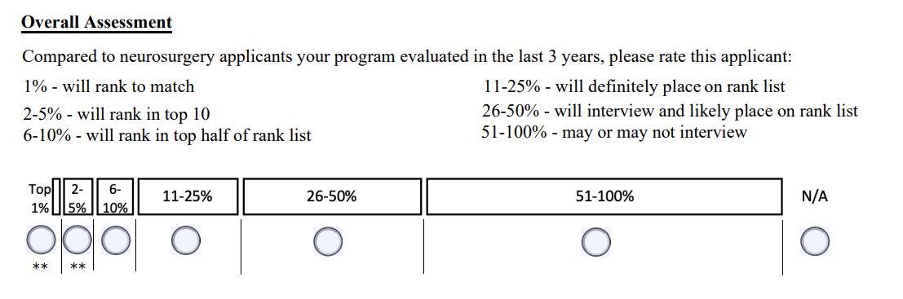
Standardized Letters - Tips
On application review, place LORs from a single author side by side

Slide 9
Preference Signaling
Guidance: Neurosurgery will offer applicants 25 signals
Applicants must signal home program and those where they did away rotations if they are interested
Key points:
Sign your program up by the deadline
Advertise your program in advance to applicants in August-ish
Consider transparency around your use of signals

Slide 10
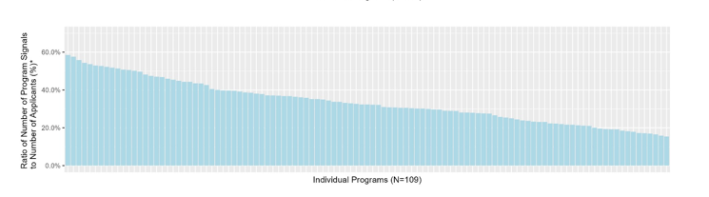
59%
18%

Slide 11
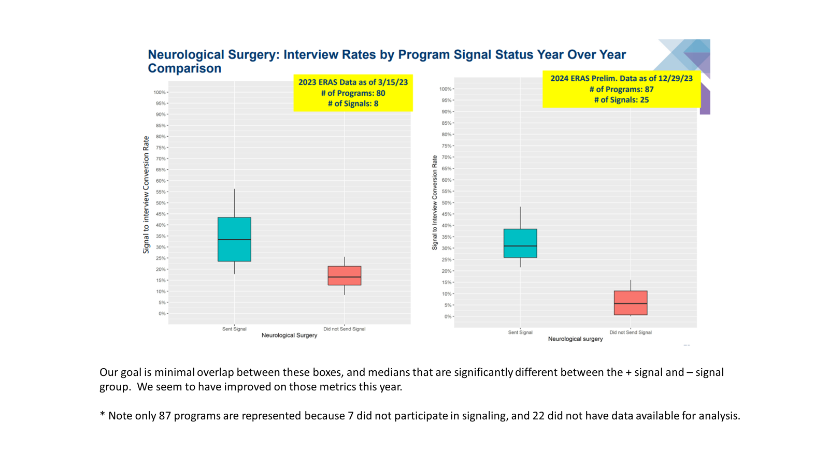

Slide 12
Standardized Interview Release Dates
Guidance: Only offer interviews during specified time period on the 4 Friday afternoons in October. Do not extend more offers than slots.
We really need your help here!

Slide 13
Interview Formats
No change to guidance is anticipated
In person or virtual is fine
Hybrid format is not allowed
Help reduce costs however you can
65% of programs went in person in 2023-24
77% of programs anticipate going in person in 2024-25

Slide 14
Campus Visits/Second Looks
Can not require these and should not use attendance to influence ranking
Keep costs down wherever possible

Slide 15

Best Practices

Slide 16
Reduce Applicant Costs
Coordinate interview/visit dates to reduce travel
Negotiate low rates for hotels, shared vans
Subsidize travel expenses
Facilitate roomshares, rideshares, etc
Beware of risks, especially if involving current employees
Use virtual processes when feasible
Offer grants for Sub-Is

Slide 17
Reduce Applicant Stress
Encourage all applicants to sign up for SNS emails!
Run sessions helping your rotators understand how to handle the application, LORs, signaling
Encourage attendance at SNS Webinars
Make sure they are excused from rotation duties
Help faculty with SLOR templates and ensure all letters are uploaded before ERAS opens to programs
Use standardized interview release dates
Maintain interview scheduling flexibility
Every date doesn’t have to have the exact same number of applicants

Slide 18

Pitfalls

Slide 19
Post – Interview Contact
Applicants can tell a program whatever they want
Programs can tell applicants how they are ranked
Programs CANNOT ask an applicant where they intend to rank the program
Programs CANNOT require an applicant to do a campus visit, explicitly or implicitly, to influence their ranking
Programs CANNOT offer more interviews then they have slots
Match violations of this kind can see a program put on probation and a PD removed from the position

Slide 20
Letters of Intent
Do not necessarily have to be sent
Should not be sent before conclusion of all interview/visit activity
Are not binding and should not be assumed to be truthful
Do not necessarily require a response
“Your program is going to be in the top of my list…top 3… etc” letters are not advised
87% of applicants said that they sent a “letter of intent” to their #1

Slide 21
Stay Updated
Emails from the SNS Leadership
Guidelines will be published in June
Summer webinars for PDs (and PCs?)

Slide 22


