Slide 1


HISTORY 202.5
Looking Back and Moving Forward
Colleen Bruton, BS, C-TAGME
Resident Program Administrator
ARANS Meeting, May 17, 2025

Slide 2
2008
February 2008 – Kathy Guzman invitation to meet.
“This will be an opportunity to get to know each other, share ideas and plan for a more organized and formal meeting in the future.”
March 1, 2008 – Eight neurosurgery coordinators attended dinner during the ACGME Annual Educational Conference at the Gaylord Texan in Grapevine, Texas.
March 25, 2008 - Proposal submission to Dr. Burchiel, SNS Secretary, for inclusion on the agenda of the SNS Council Meeting in May.
May 2008 - Natalee Kelaher, Baylor COM, started Yahoo group
Notes:
Primary communication via the ABNS Listserv, December 2007 a series of emails recommending organizing a neurosurgery coordinators meeting

Slide 3
SNS Support
From: Siobhan Bradley <bradleys@ohsu.edu>
Sent: Wednesday, January 14, 2009 3:07 PM
Subject: 2009 Neurological Surgery Resident Coordinator Meeting Registration- REMINDER
Dear Neurosurgery Program Coordinators-
We are delighted to announce the first national Neurological Surgery Resident Coordinators meeting. The meeting will take place May 14-15th, immediately preceding the 2009 annual meeting of the Society of Neurological Surgeons in Salt Lake City, Utah.
Notes:
Siobhan Bradley – admin support to then SNS President Burchiel, at the beginning we used the same room blocks and needed to depart to ensure room for the SNS Meeting participants.

Slide 4

2009
Program Coordinators inaugural meeting in conjunction with the in the 89th year of the SNS and 100th Meeting of the Society.
Notes:
1920-1931 the SNS met twice a year.

Slide 5
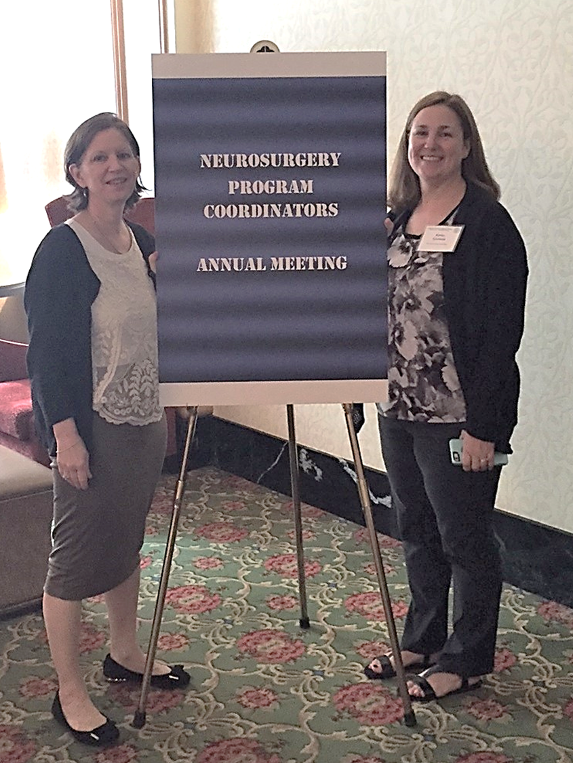
Inaugural Leadership
Kathy Guzman
Lois Hengenius
Notes:
Kathy and Lois lead our stellar group from the beginning.

Slide 6
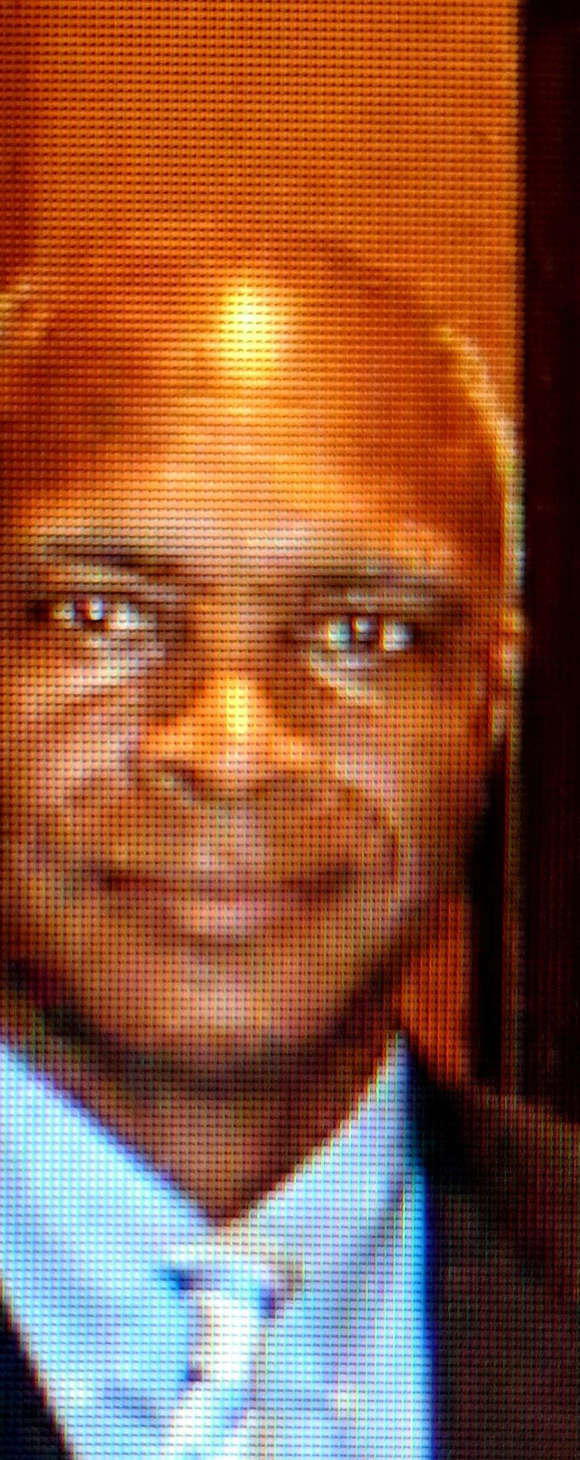

2007
Accreditation Data System (ADS)
Effective July 1, 2007, transition to the ACGME web-based operative log system including the data entry for all residents enrolled in ACGME approved positions
Larry Sulton, PhD
Executive Director
Residency Review Committee for Neurological Surgery
Notes:
Dr. Sulton – former director of the ACGME RRC for Neurosurgery

Slide 7

In 2009, transition of the PGY1 to Neurosurgery with an exit from the early San Francisco Match
and transition to the NRMP
ERAS and PDWS
Notes:
San Francisco Match results January/February then The National Resident Matching Program is a second match and a pro-forma match, but it is a necessary step in the matching process.
They will begin their Surgery Internship June 24, 2008 and join us July 1, 2009!

Slide 8
2012

Slide 9
2016-2018
Project Volunteers - Colleen Bruton and Penny Schwab

Slide 10
2019
Name change from the SNS Coordinators Group to
The Association of Resident Administrators in Neurological Surgery
(ARANS)
Notes:
What’s in a name? Dr. Derstine, former ACGME Director supported recognition of job responsibilities under the title of Administrator. Now some are Coord, Directors, Managers

Slide 11


October 2019
Inaugural Coordinators Session
San Francisco, CA
Notes:
Invitation for ARANS to attend

Slide 12
Covid-19 Pandemic
Virtual Meetings
March 2020
May 2020 Philadelphia Meeting Cancelled
October 2020 - Interim Meeting, Virtual
May 2021 – Annual Meeting, Virtual

Slide 13



Establishing Organizational Structure
2020
Ingrid Menendez
Univ. of Miami - Neurosurgery, Administrative Director of Education Prgms.
Roberto Suazo
Graphic Design Project Manager
for the Department of Neurological Surgery
University of Miami Miller School of Medicine
Notes:
Bylaws and initiation of Executive Committee, Logo, Gavel

Slide 14
2021 Website
Sent: Wednesday, January 13, 2021
The Executive Committee is pleased to announce the opening of the official ARANS Website at www.nsadmin.org.
A Home Page with a sign-up area for New Membership Applications
An About Page, highlighting current ARANS Leadership and Contact Information
A Resources Page providing Web Resources for Administrators
Members Site (Protected)
    ARANS Updates
    ARANS Blog Posts
    Administrator Forum
    Annual Meeting Archive – Including Photos and Presentations
Notes:
End of the Yahoo Groups, Alison Gorman, Beth Battiste, Colleen Bruton

Slide 15
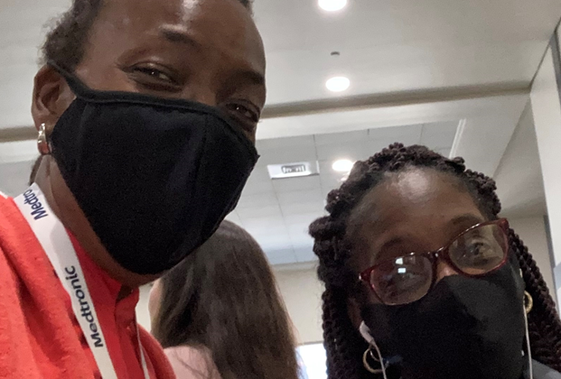


Return to In-Person Meetings with the Joint SNS-CNS Meeting
2021
Notes:
Masking protocols

Slide 16
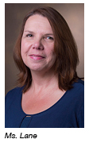
Program Manager
2021
Initiation of Regional Groups
Pam Lane is the Neurosurgery Program Manager at Vanderbilt University Medical Center. Pam started her career in Graduate Medical Education in June 2000 working with a busy spine surgery fellowship program in Texas. She moved to Tennessee in 2012 and joined Vanderbilt in early 2013.
Pam enjoys the fast pace and challenges of working with surgical residency and fellowship programs. Her interests include innovation in academic education and mentoring other administrators in GME. She recently became TAGME certified and was named President Elect of the Association of Residency Administrators in Neurosurgery.
https://www.vumc.org/neurosurgerydept/program-leadership
Pam Lane
President-Elect, ARANS (Association of Residency Administrators in Neurological Surgery)
Neurosurgery Residency Program Manager
Vanderbilt University Medical Center

Slide 17
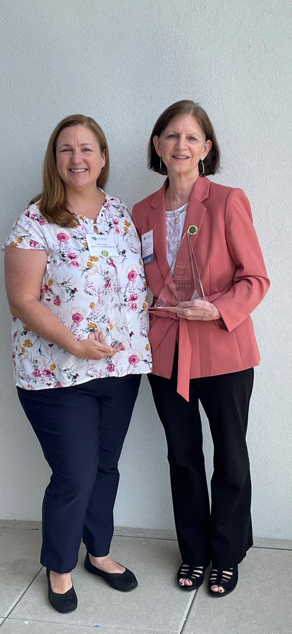

2023
Recognition Awards
Kathy Guzman
Lois Hengenius
Inaugural Recipients
of the
Society of Neurological Surgeons Administrator of the Year
Award
Service Years Pins
Notes:
2023 Co Awardees – Administrator of the Year

Slide 18
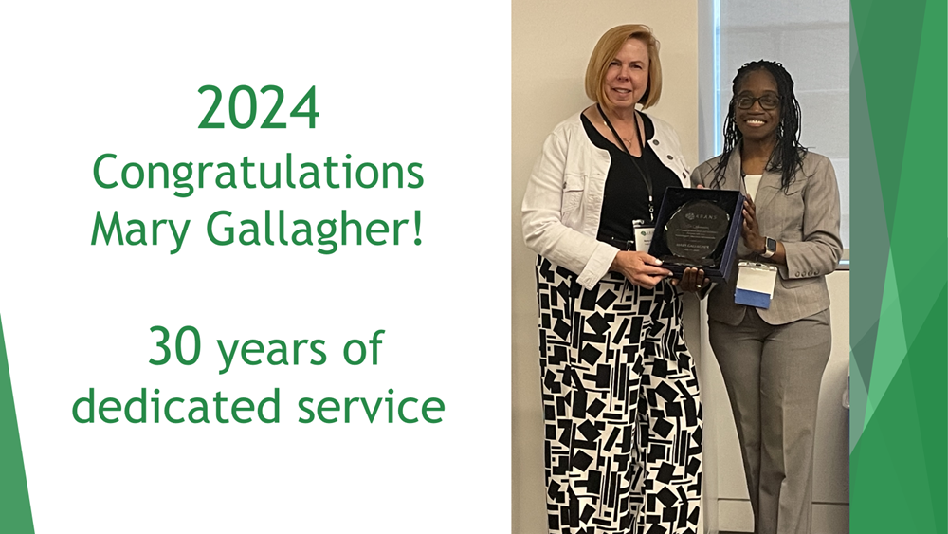

Slide 19
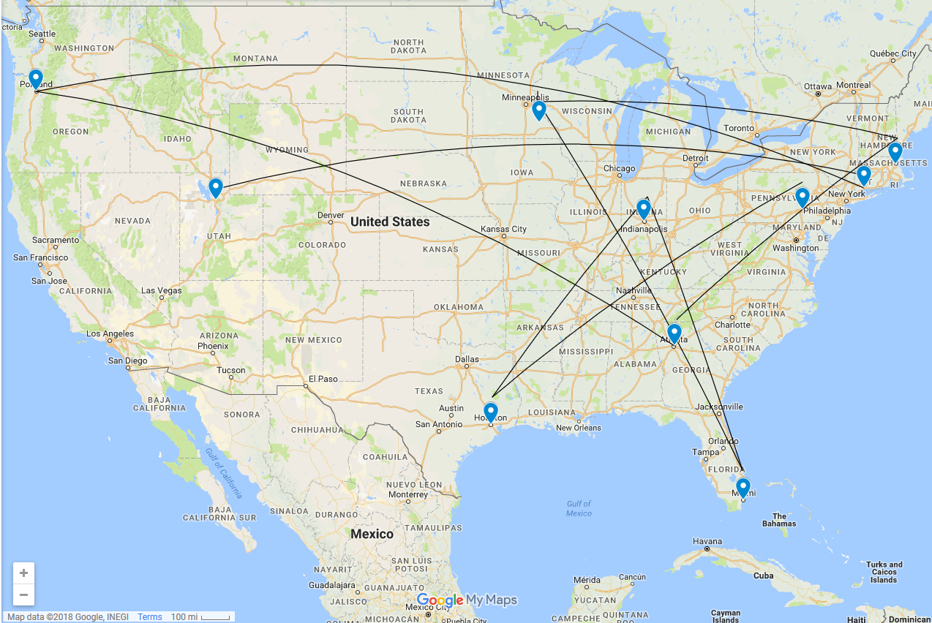




14
17
16
10
12-Zoom
15
13

Slide 20
POP QUIZ!
???

Slide 21


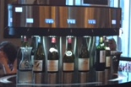


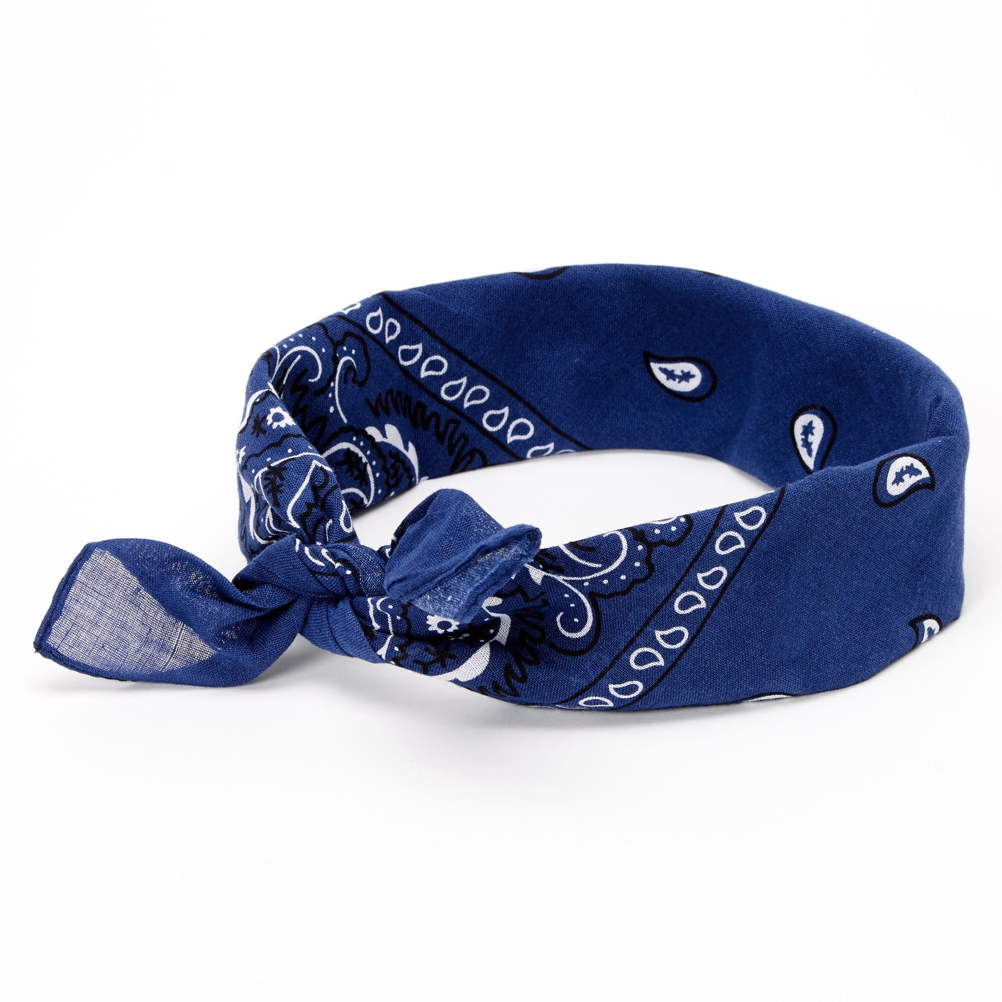


Name the City!

Slide 22
Looking forward
ARANS Meeting Save-the-Dates!
18th Annual Meeting - Birmingham Alabama
19th Annual Meeting - Providence, Rhode Island
20th Annual Meeting – Los Angeles, California
Notes:
Look forward to seeing you at the next meetings, thank you for your time and attention today.

Slide 23
You are now a part of the ARANS story. We need your enthusiasm and engagement to ensure ARANS continues to evolve to be the best version of support and recognition for Neurosurgery Administrators.
Can we count on you?
ENGAGE, PARTICIPATE, LEARN, MENTOR
Notes:
ARANS is for and needs YOU! your local GME community, Get involved in a regional meetings, Attend ARANS, run for office – passing the baton to keep the organization relevant, current and engaged. Evolving, If your current work-life situation has a window of opportunity

Slide 24

Opportunities and Project Opportunities
Website,
Social Media
Executive Committee
Historian, Data Tracking
Photography
This Photo by Unknown Author is licensed under CC BY
Notes:
Photographer, website & forum committee, happy to put myself out of a job.

Slide 25
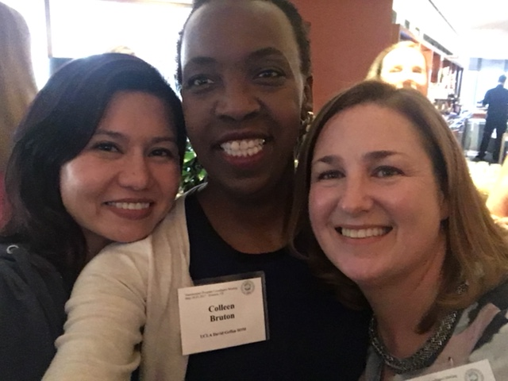
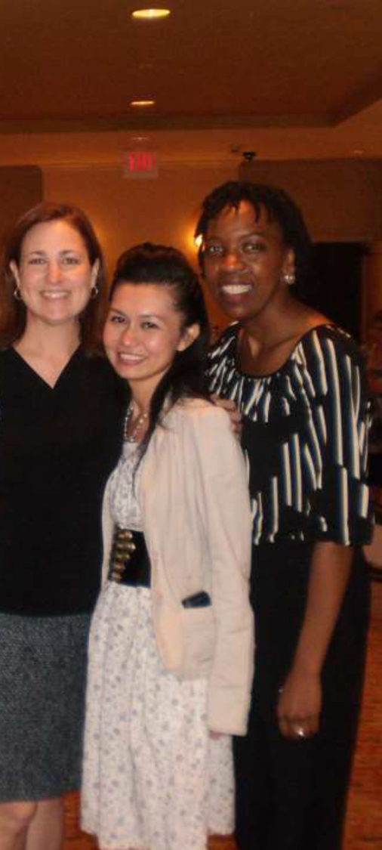

Administrator/Coordinator Database
Kathy Guzman, USC
ARANS Co-Founder and Past President
Samantha Phu, Cedars Sinai
ARANS President-Elect
Colleen Bruton, C-TAGME, UCLA
2024 ARANS Vice-President and Administrator Award
Notes:
friends previously worked in the DIVISION of Neurosurgery, cities with multiple programs

Slide 26
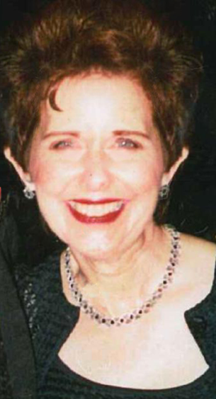
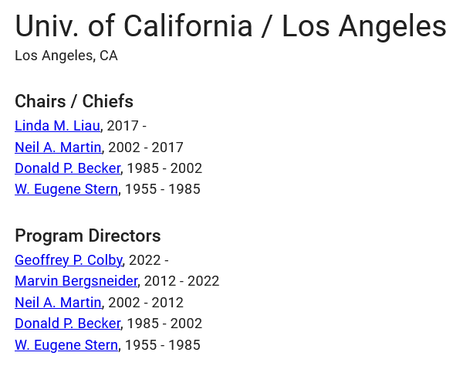
Neurosurgery Administrator Database
California Neurosurgery Program | Coordinator
Loma Linda University | Linda Barron
Stanford University | Lynelle Acosta
University of California, Davis | Katheryne Keyes, Sherri Albericci
University of California, Irvine | Sandy Norell
University of California, Los Angeles | Patricia Macdonald
University of California, San Diego | Glenna Tirazona, Patty
University of California, San Francisco | Nancy Loewe, Marilyn Abert (sic)
Reference Project: SNS Neurosurgen Project
https://www.neurosurgen.com/
Neurosurgen UCLA
https://thejns.org/view/journals/j-neurosurg/aop/article-10.3171-2024.7.JNS232995/article-10.3171-2024.7.JNS232995.pdf
Reference Project: Academic Tree
https://academictree.org/neurosurgery/
Patricia Macdonald, UCLA

Slide 27



Thank you to our parent and partner organizations for their support and collaboration

Slide 28

Notes:
History . . . My non-favorite subject in middle school . . . What does what happened in the 15th century have to do with me? Stand up stretch and get ready to be engaged in our collective history. Hopefully minimizing anecdotal ramblings.
Who knows Laurel & Hardy, Luke and Laura, Barack and Michelle, Bennifer, Giannattta and Guzman? That’s all history . . . Let’s dive in

