Slide 1
ARANS Interview Season Survey Review Reflections, Data, and Discussion
Beth Battisti, MHA, C-TAGME
Program Manager, Cleveland Clinic Neurosurgery
May 17, 2025

Slide 2
Background & Objectives
Background
This survey was conducted to identify current trends in neurosurgery residency interview practices among ARANS members. The goal was to better understand how programs structure their interview process, identify common challenges and unique strategies, and create opportunities for discussion and sharing of best practices.
Objectives
Review trends in interview formats and scheduling
Highlight unique interview practices
Share personal reflections and planned improvements
Discuss Sub-I matching and post-match surveys
Encourage idea sharing and collaboration

Slide 3
Survey
Responses collected via Microsoft Form
Sent to all program administrators on ARANS membership list
57% of programs responded
Notes:
67/117 programs

Slide 4
Interview Trends
Majority of programs conducted in-person interviews in 2024
In-person: 59
Virtual: 8
Popular interview days
Thursday
Friday
Saturdays
Notes:
Question- those who conducted virtual- are you going back to in person in 2025? What are your barriers?

Slide 5
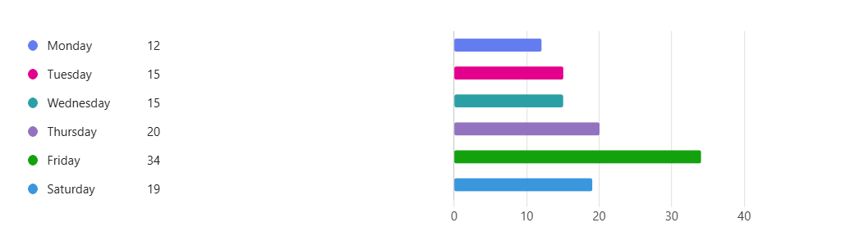
Which days of the week were interviews hosted?

Slide 6
Tools Used
Thalamus
Application Review (Cortex)
Virtual Interviews
Scheduling
Creating itineraries
Scoring applicants
Rank list

Slide 7
Tools Used
Rez Rate
Scheduling
Creating itineraries
Scoring applicants
Rank list

Slide 8
Tools Used
ERAS
Application Review
Zoom
Virtual Interviews
Notes:
Programs do manual scheduling- emails/ excel, don’t rely on a system

Slide 9
Applicants Interviewed vs Matched Positions
Matched Spots per Program
Mean: 2.26
Median: 2.0
Range: 1 to 4
Applicants Interviewed per Program
Mean: 40.29
Median: 38.0
Range: 22 to 55
Applicants per Available Spot
Mean: 21.22
Median: 18.67
Range: 9.33 to 55.0
**These numbers are reflective of programs who participate in survey, not all Match participants**
Notes:
This suggests that on average, programs interview about 21 applicants for each available residency position, with a notable range depending on the program. Let me know if you’d like this visualized or broken down further.

Slide 10
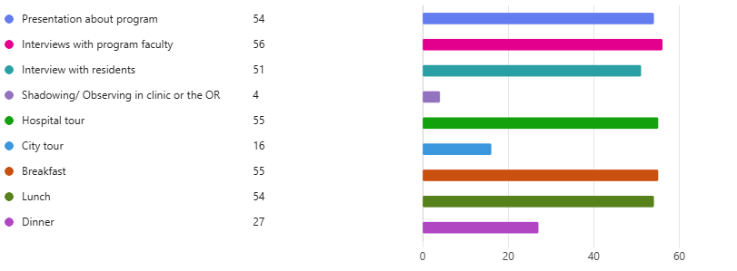
Interview Day Activities
Notes:
- Unique experiences: City Tour, OR Shadowing- can people share how they conduct this part of the day?
- Dinner- is this post interview, do you host a dinner the evening before as well?

Slide 11
Common Struggles
Budget
Staff Availability
Space
Notes:
- Most administrators who were in person noted that these same issues were relevant when they interviewed virtually

Slide 12
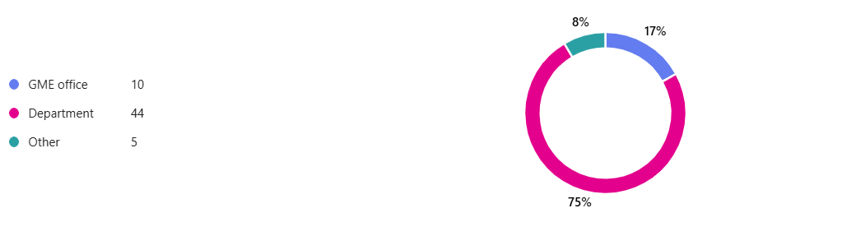
Budget
Notes:
- Other: combination of GME and department; private practice

Slide 13
Budget
Most programs do not have a set per applicant budget
Interview/ Recruitment expenses include:
Catering
Swag
Hotel accommodations
Tour bus
Notes:
Institutions set a meal cap per person

Slide 14
Reflections on Returning to In-Person
Benefits: engagement, hospital/city exposure
Challenges: logistics, cost, faculty time
Note-taking and mid-season improvements

Slide 15
Looking Ahead: Plans for Next Year
Streamline interview flow and communication
Use feedback for real-time updates
Try new tools/templates for scheduling

Slide 16
Live Polls
Did your program match all Sub-Is?
Did your program match a majority of Sub-Is?
Sub-I application fees

Slide 17
Open Discussion- Post Match Survey
Who distributes post-match surveys: Program vs GME
What data is collected?
How is the data used to inform next season?

Slide 18
Final Takeaways & Next Steps
Always aim for continuous improvement on interview/ recruitment strategies
Continue collaboration and best practice sharing
Thank you!

Slide 19
Final Takeaways & Next Steps

