Slide 1
“CCC & PEC and a ‘Year of No Fear’: How are they connected?”
Tobi J. Cooney, BA, C-TAGME
ARANS New Coordinator Workshop
May 15, 2025

Slide 2

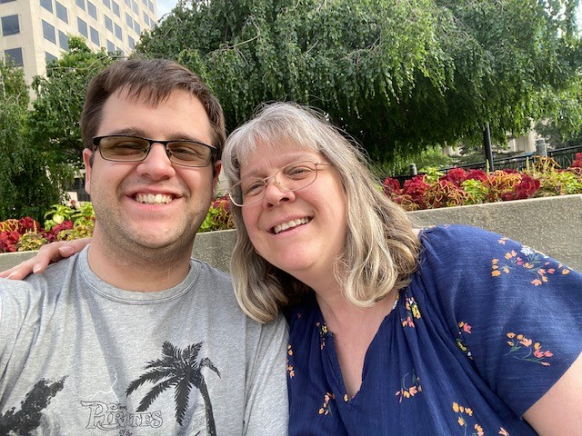
Fun Facts
No conflicts of interest to disclose
PC for how long?
Previous medical or GME experience?
Degree in Administration?
Favorite part of my job
Hobbies

Slide 3
Goals/Objectives
Understand what information needs to be reviewed at the CCC and PEC meetings
Understand the Program Coordinator’s role within the CCC & PEC meetings process
Learn various ways to incorporate wellness in your life
Gain an understanding of the network available to you

Slide 4
CCC (Clinical Competency Committee) Meeting

Slide 5
CCC (Clinical Competency Committee)
Per the reformatted ACGME Neurological Surgery Common Program Requirements (CPR) effective 7/1/2025:
5.3. A Clinical Competency Committee must be appointed by the program director. (Core)
5.3.a) At a minimum, the Clinical Competency Committee must include three members of the program faculty, at least one of whom is a core faculty member. (Core)
5.3.b) Additional members must be faculty members from the same program or other programs, or other health professionals who have extensive contact and experience with the program’s residents. (Core)

Slide 6
CCC (Clinical Competency Committee)
Reformatted ACGME Neurological Surgery Common Program Requirements (CPR) effective 7/1/2025 continued:
5.3.c) The Clinical Competency Committee must review all resident evaluations at least semi-annually; (Core)
5.3.d) The Clinical Competency Committee must determine each resident’s progress on achievement of the specialty-specific Milestones; and, (Core)
5.3.e) The Clinical Competency Committee must meet prior to the residents’ semi-annual evaluations and advise the program director regarding each resident’s progress. (Core)

Slide 7
CCC (Clinical Competency Committee)
Information needed for CCC meeting:
* ACGME Resident Case Logs minimums report
* Evaluations – Faculty, Nursing, 360
* Milestones
* ABNS Written Exam results
* Resident Self Evaluation
* Individual Resident Achievements: their scholarly activity; QI or research; served on any committees locally or nationally; honors or awards; attended any meetings/courses; upcoming plans

Slide 8
CCC (Clinical Competency Committee)
At the CCC meeting each resident will be reviewed individually
Milestones need to be entered in ACGME ADS for each resident, either during the meeting or at its conclusion
Save meeting minutes in your RMS (Residency Management System, either MedHub or New Innovations).

Slide 9
Questions?

Slide 10
PEC (Program Evaluation Committee) Meeting

Slide 11
PEC (Program Evaluation Committee)
Per the reformatted ACGME Neurological Surgery Common Program Requirements (CPR) effective 7/1/2025:
5.5. Program Evaluation and Improvement: The program director must appoint the Program Evaluation Committee to conduct and document the Annual Program Evaluation as part of the program’s continuous improvement process. (Core)
5.5.a. The Program Evaluation Committee must be composed of at least two program faculty members, at least one of whom is a core faculty member, and at least one resident. (Core)

Slide 12
PEC (Program Evaluation Committee)
Reformatted ACGME Neurological Surgery Common Program Requirements (CPR) effective 7/1/2025 continued:
5.5.b. Program Evaluation Committee responsibilities must include review of the program’s self-determined goals and progress toward meeting them. (Core)
5.5.c. Program Evaluation Committee responsibilities must include guiding ongoing program improvement, including development of new goals, based upon outcomes. (Core)
5.5.d. Program Evaluation Committee responsibilities must include review of the current operating environment to identify strengths, challenges, opportunities, and threats as related to the program’s mission and aims. (Core)

Slide 13
PEC (Program Evaluation Committee)
Reformatted ACGME Neurological Surgery Common Program Requirements (CPR) effective 7/1/2025 continued:
5.5.e. The Program Evaluation Committee should consider the outcomes from prior Annual Program Evaluation(s), aggregate resident and faculty written evaluations of the program, and other relevant data in its assessment of the program. (Core)
5.5.f. The Program Evaluation Committee must evaluate the program’s mission and aims, strengths, areas for improvement, and threats. (Core)

Slide 14
CCC
PEC
APE
ADS
Notes:
Explain how the information flows from the CCC to inform the PEC to be used for your APE which then is used to update your ADS

Slide 15
PEC (Program Evaluation Committee)
Purpose of the PEC is to review the topics that need to be included in your APE (Annual Program Evaluation):
Resident Performance
Faculty Performance
Graduate Performance
Program Quality

Slide 16
PEC (Program Evaluation Committee)
Resident Performance
ACGME Case Logs Minimums Report
ACGME Resident Survey results
ACGME Resident Wellness Survey results
ABNS Written Primary Exam Board scores
Resident Scholarly Activity
Resident Accomplishments

Slide 17
PEC (Program Evaluation Committee)
Faculty Performance
ACGME Faculty Survey results
ACGME Faculty Wellness Survey results
Faculty Scholarly Activity
Faculty Accomplishments

Slide 18
PEC (Program Evaluation Committee)
Graduate Performance
ABNS Oral Board Pass Rate
Per the reformatted Neurosurgery CPR effective 7/1/25:
5.6.b. For specialties in which the ABMS member board and/or AOA certifying board offer(s) an annual oral exam, in the preceding three years, the program’s aggregate pass rate of those taking the examination for the first time must be higher than the bottom fifth percentile of programs in that specialty. (Outcome)
5.6.d. For each of the exams referenced in 5.6.a.-c., any program whose graduates over the time period specified in the requirement have achieved an 80 percent pass rate will have met this requirement, no matter the percentile rank of the program for pass rate in that specialty. (Outcome)

Slide 19
PEC (Program Evaluation Committee)
Program Quality:
3-5 year board pass rate (both written and oral boards)
Learning Environment – Curriculum/Goals & Objectives for rotations
Previous year’s APE and Action Plan
ACGME Citations/AFIs and Letter of Notification
Faculty & Resident Evaluations of the Program – review anonymous comments regarding areas for improvement and program strengths
Applicant survey results (sent after Match Day)

Slide 20
PEC (Program Evaluation Committee)
Program Quality continued:
SWOT analysis
Strengths
Weaknesses
Opportunities
Threats

Slide 21
Questions?

Slide 22
Program Coordinator Wellness

Slide 23
Program Coordinator Wellness
Exercise – move your body every day
Nutrition – try to have 2 out 3 meals be healthy
Sleep – try to get 6-8 hours a night
Hobbies – what brings you joy? Make sure you get some joy each day

Slide 24
Program Coordinator Wellness
Need to advocate for yourself. No one knows what you need better than you.
Set clear boundaries on when you are available:
What are your work hours?
Is it better to reach you by email, text, phone?
Tell the residents at orientation and keep repeating it throughout their training
Notes:
Your need to tell people what you need. Those people can be your PD, your residents, your GME Manager, you family.
Use example of CCC/PEC mtg needs to be in PM because you have AM school drop off

Slide 25
Program Coordinator Wellness
Advocate to attend meetings such as ACGME or ARANS
This is part of your professional development
Have your practice manager make sure funds for you to attend meetings is included in the program budget

Slide 26
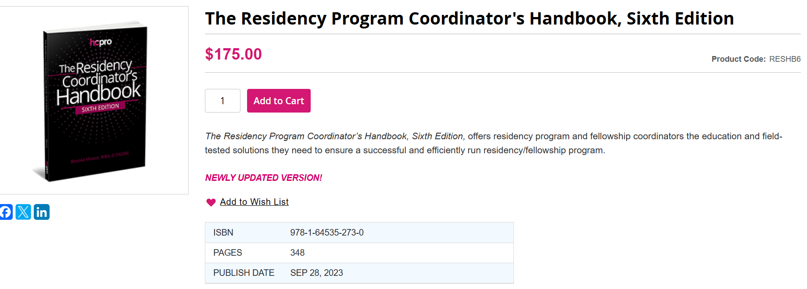
The Residency Program Coordinator’s Handbook, Sixth Edition

Slide 27
Program Coordinator Wellness
Professional Development and/or Networking opportunities:
ARANS meeting
ACGME or AHME meetings
NSAMA – both their virtual one day conference in April and their monthly virtual educational sessions
Texas College of Osteopathic Medicine’s Academy for Program Coordinators (APC) monthly virtual educational sessions
National Conference for Women
ERAS, NRMP and Thalamus webinars
TAGME
Face Book group – GME Program Administrators/Educators

Slide 28



Program Coordinator Wellness
“Year of No Fear”
Hiking 5 National Parks in Utah
Scanning Groceries
Buying a new car
ARANS New Member Liaison
Promotion to Senior Program Coordinator
Step into your courage

Slide 29
Professional Development Resources for PCs
ARANS https://nsadmin.org/
ACGME https://www.acgme.org/ or AHME https://ahme.org/ meetings
NSAMA https://www.nsama.org/ National Society of Academic Medical Administrators for both their virtual one day conference in April and their monthly virtual educational sessions
Texas College of Osteopathic Medicine’s Academy for Program Coordinators (APC) monthly virtual educational sessions
National Conference for Women https://www.conferencesforwomen.org/national-conference/
ERAS, NRMP and Thalamus webinars
TAGME https://tagme.org/
Face Book group – GME Program Administrators/Educators https://www.facebook.com/login/?next=https%3A%2F%2Fwww.facebook.com%2Fgroups%2F124150454922173%2F

Slide 30
Resources for this presentation
ACGME Neurological Surgery Common Program Requirements

Slide 31
Questions?

