Slide 1

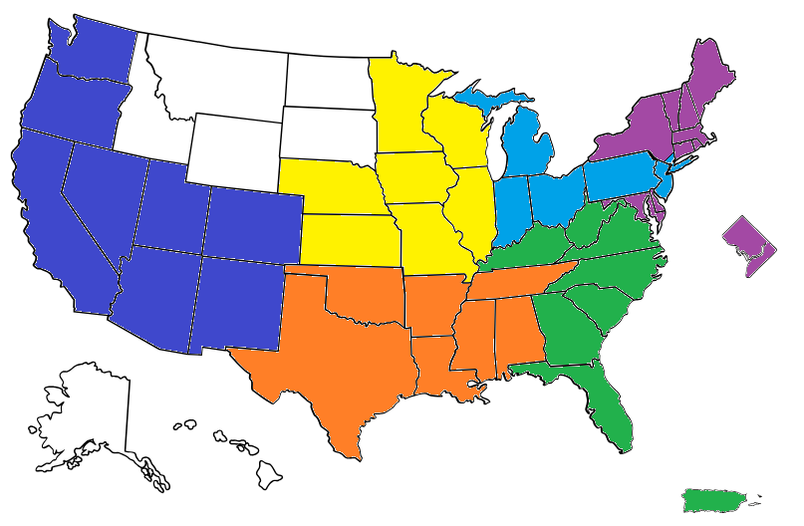
Regional Groups
Midwest North
Upper
Northeast
West: Shannon Winchester
Midwest: Laura Walker
Great Lakes / North: Beth Battisti
Upper Northeast: Courtney Gilligan & Isabelle Schulte
Southeast: Lauren Wilson
South Central: Lori DePriest
West
North
Southeast
South
Central

