Slide 1
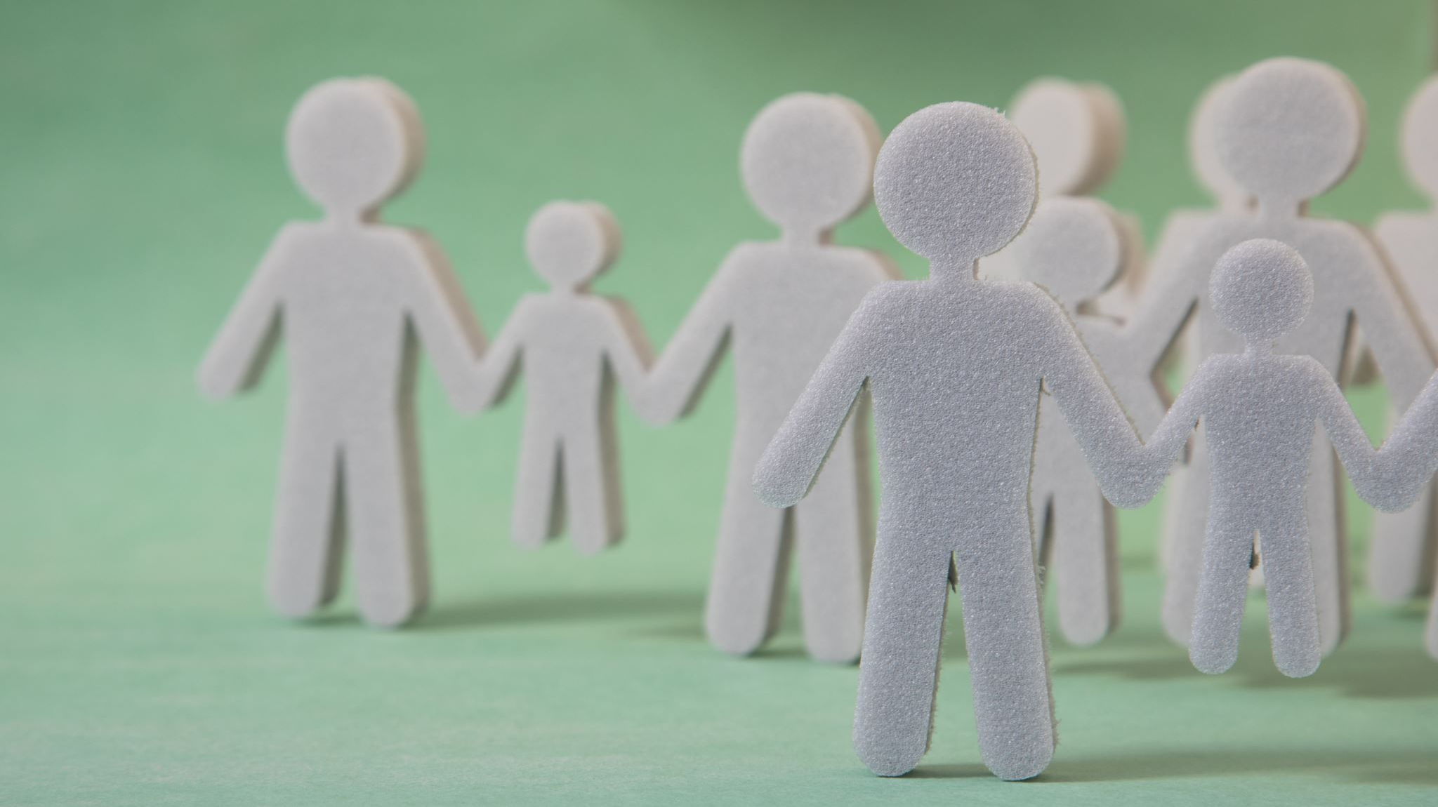
Team Building:
Origami Challenge
ARANS
May 17, 2025
Jose Gonzalez, C-TAGME
Riverside University Health System
Pam Lane, C-TAGME
Vanderbilt University Medical Center

Slide 2
Objectives
The challenges require teams to work together to complete a given origami task within a specified time frame, promoting effective teamwork and encouraging individuals to contribute their unique ideas and skills.
Foster collaboration, communication, and problem solving
Interact with others to complete a project
Advanced understanding of indirect and direct communication

Slide 3
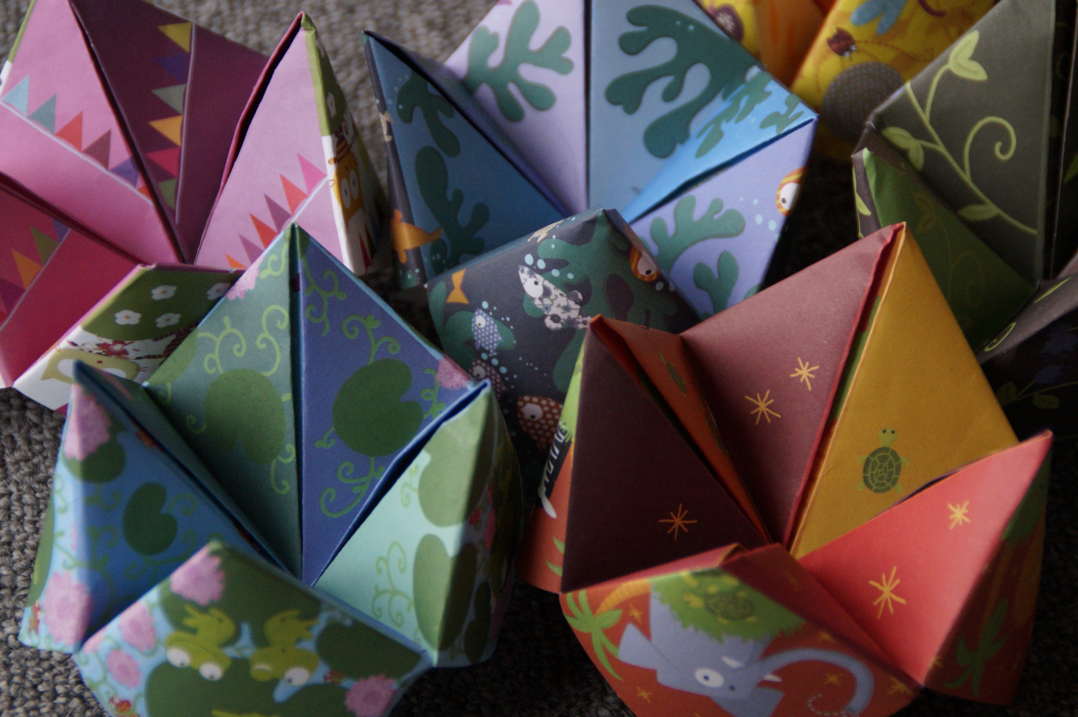
Instructions
Each team of 20 has 4 animals. Each person has instructions on how to fold their animal part.
When instructed, find others in your team who have the other parts to your animal by using creative communication.
Do not tell anyone what part you have but use creative language to describe what you hold.
Work together as a team to build the 4 animals.
Bring the completed team animals to the podium area.

Slide 4

Communication Challenges
Organizational Skills
Teamwork
Following instructions

