Slide 1
Welcome!
Nathan R. Selden, PhD, MD
Dean, School of Medicine
Executive Vice President
Campagna Chair in Pediatric Neurological Surgery
Oregon Health & Science University

Slide 2
ARANS and the SNS
2008
Kathy Guzman & Lois Hengenius propose society at ACMGE PC meeting
2009
First meeting in Salt Lake City, paired with SNS Annual meeting
2019
ARANS established

Slide 3
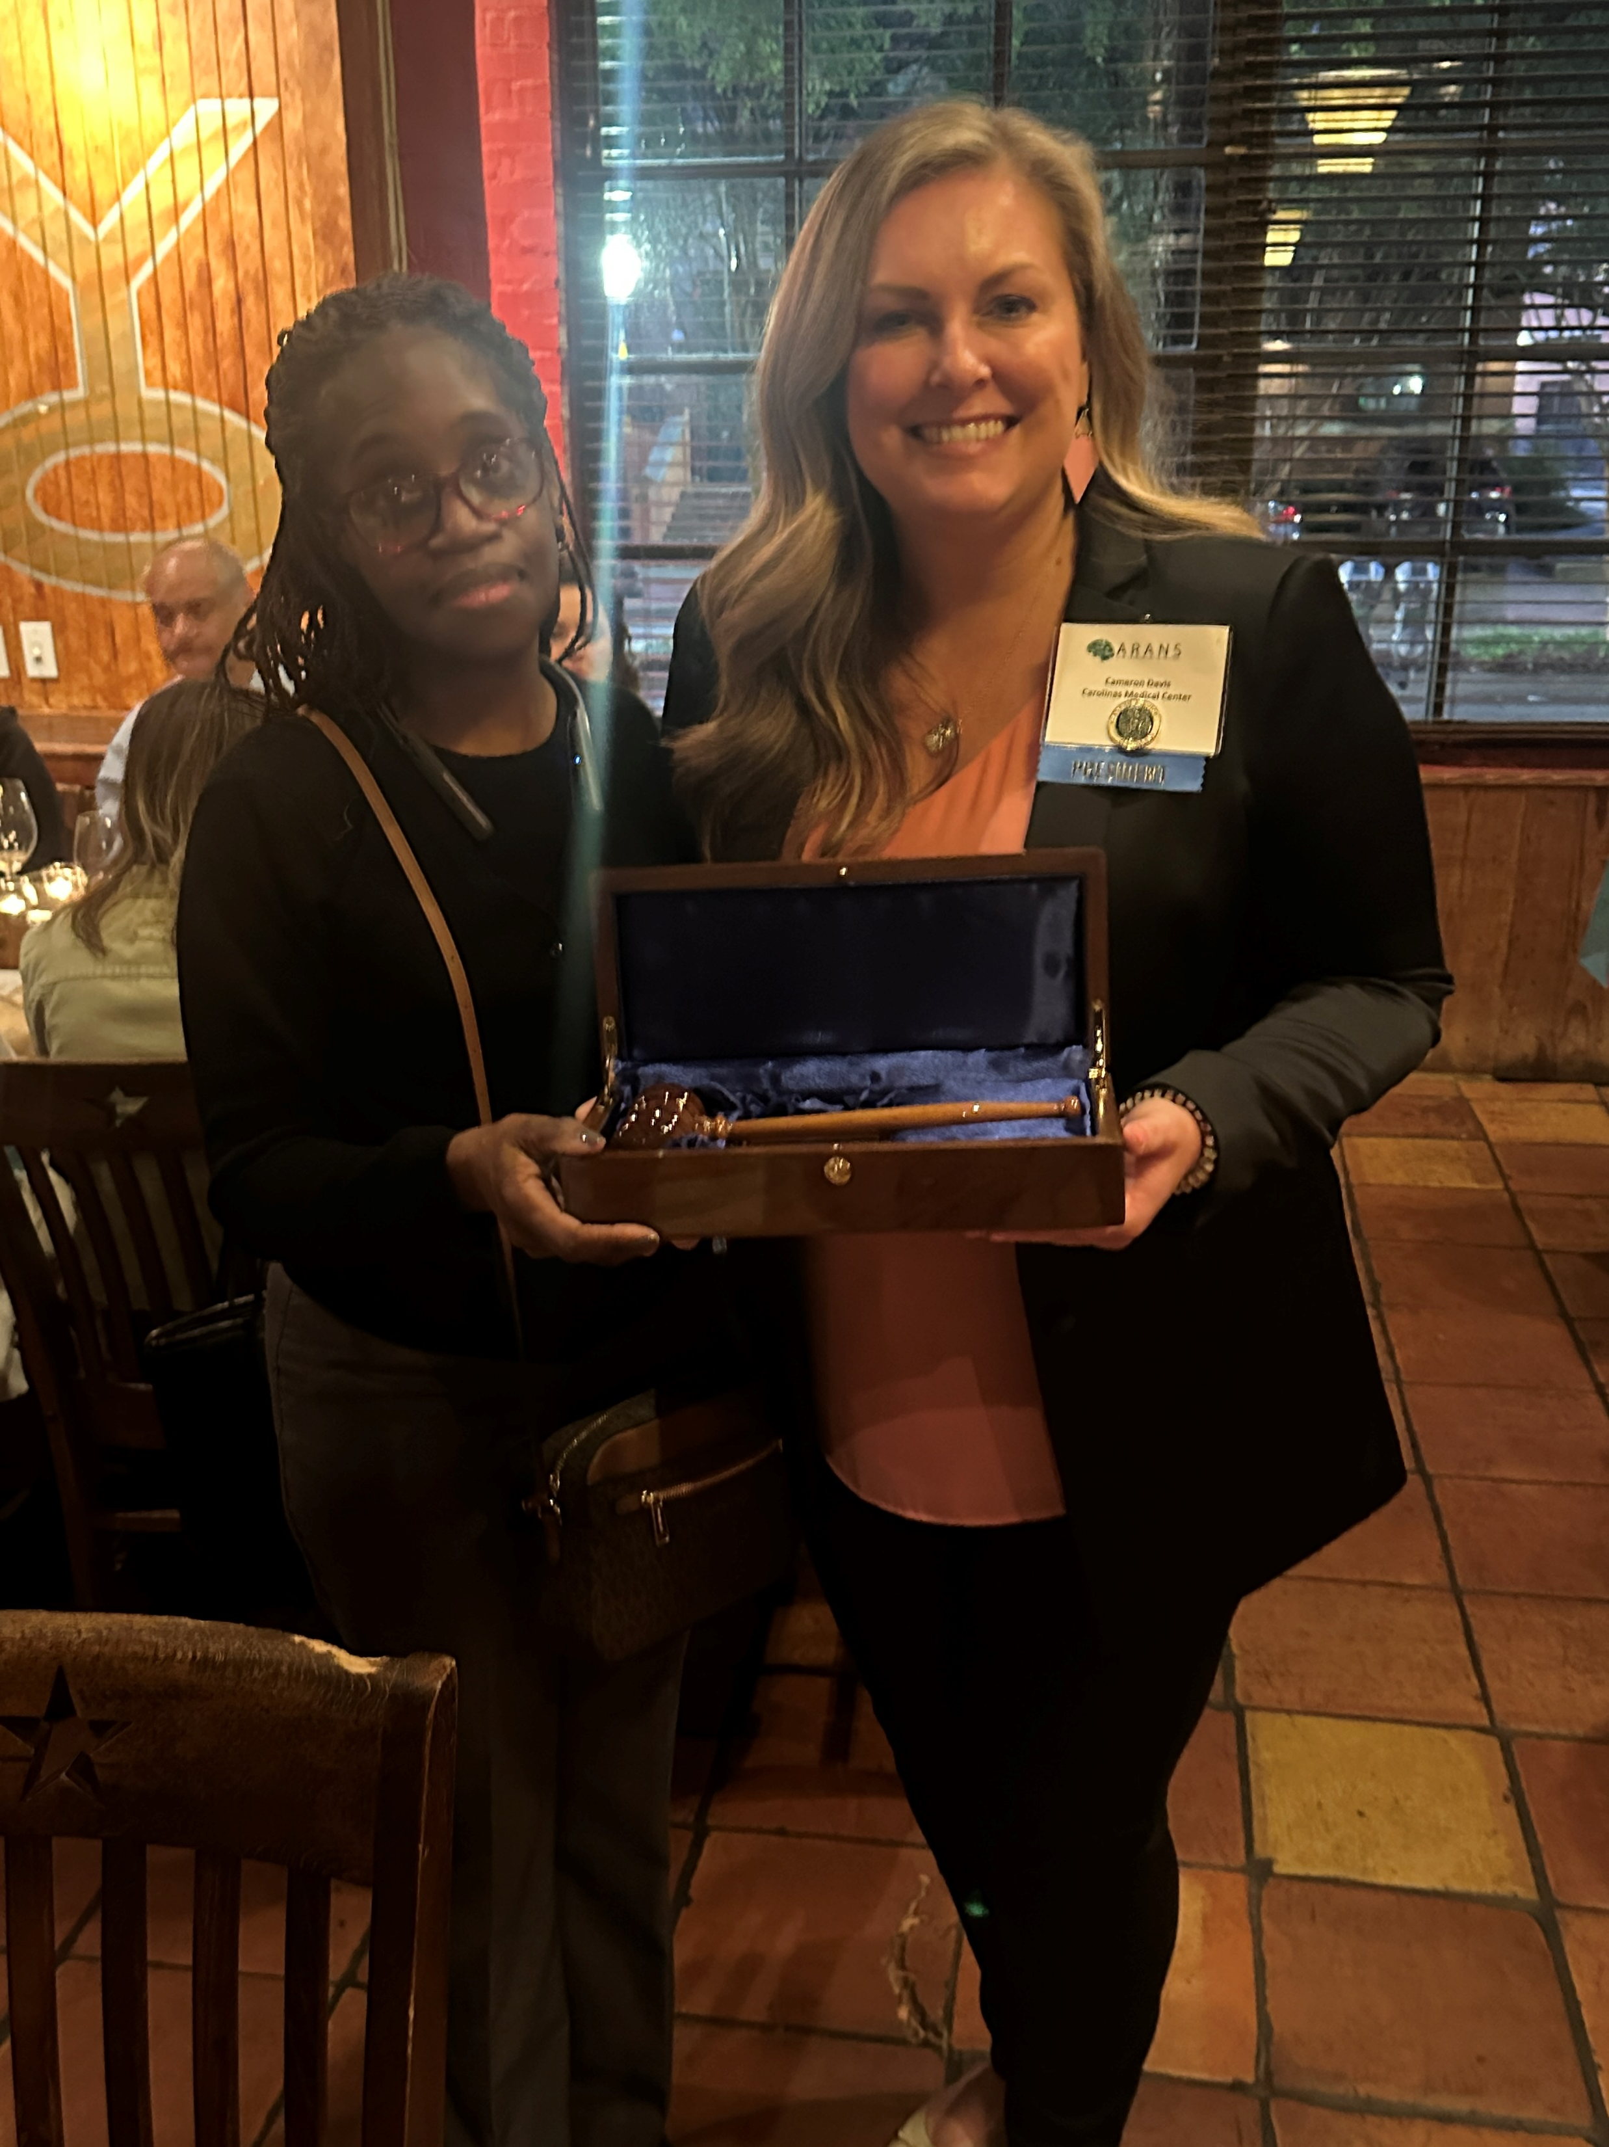
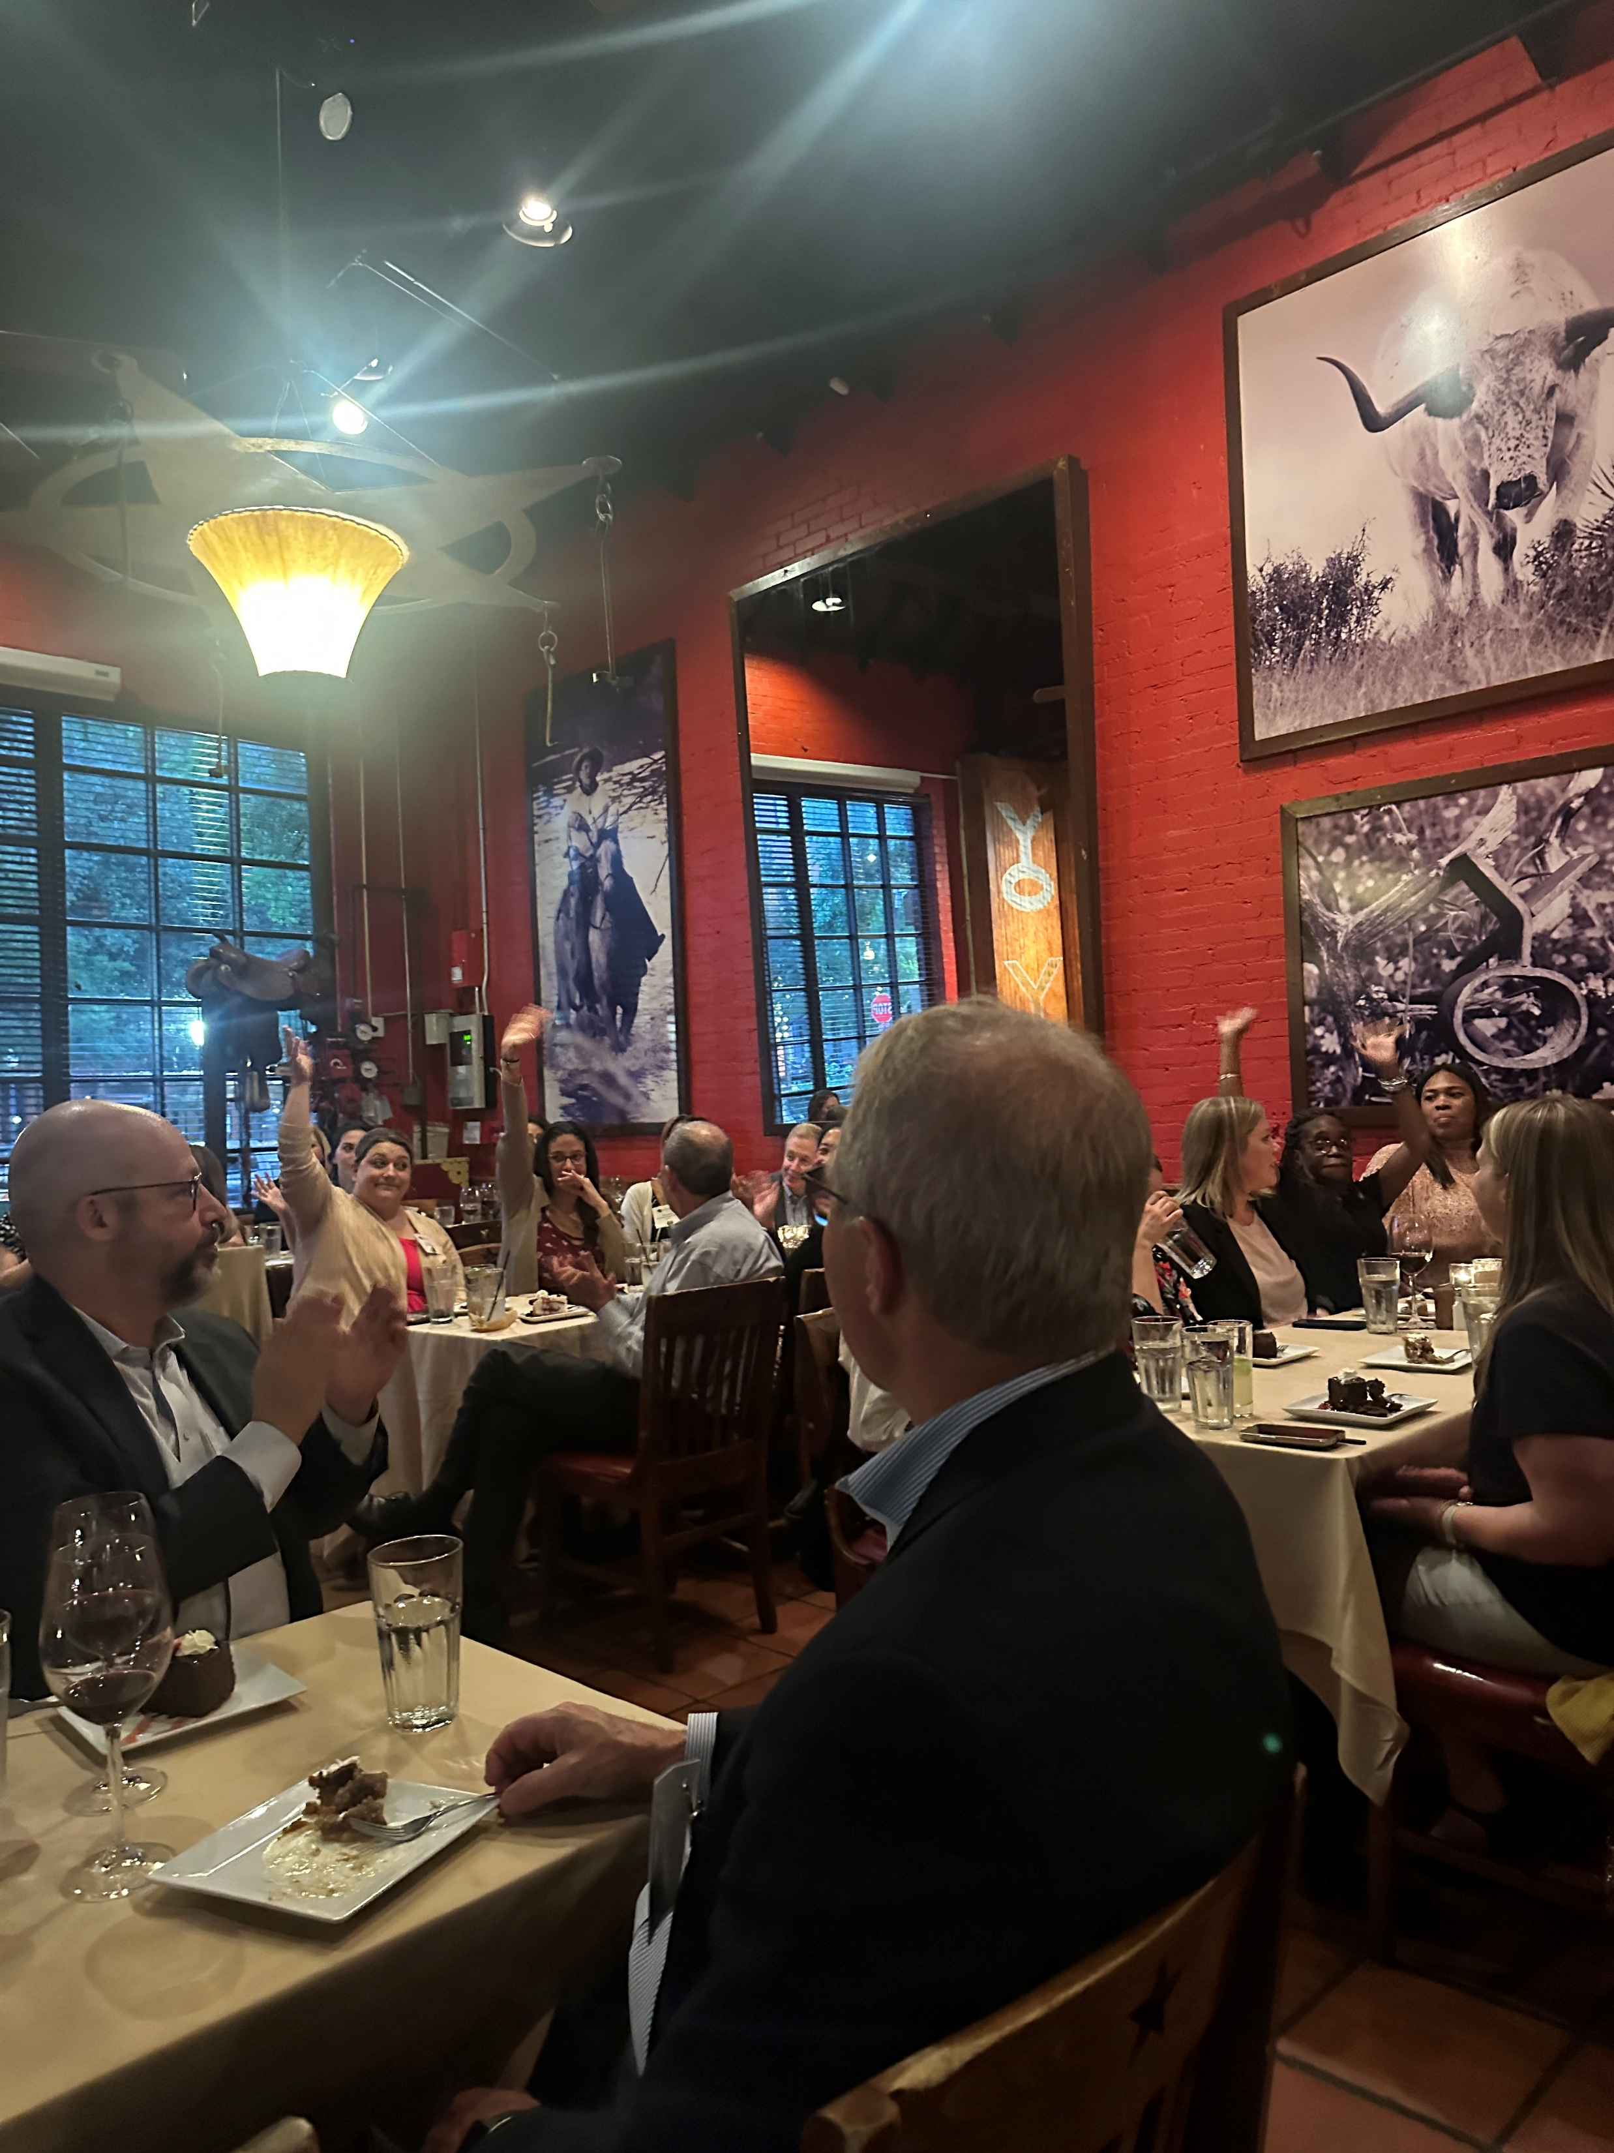
Shared Traditions and Culture

Slide 4
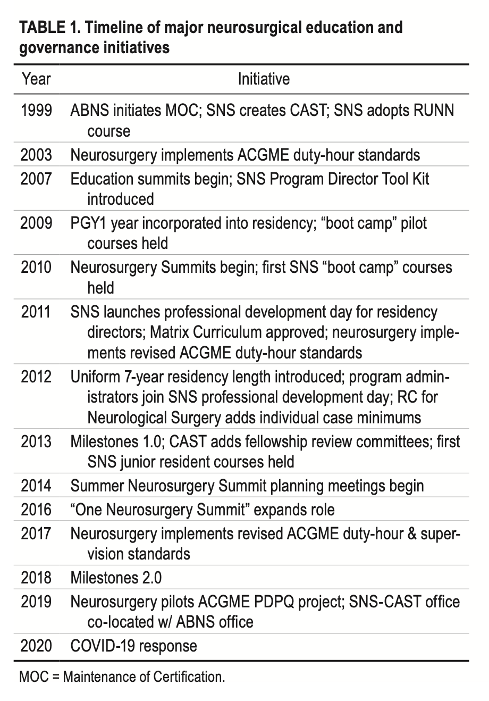
ARANS & SNS
Emphasis on Professional Development and Interprofessional Learning
2011 meeting: Saturday afternoon professional development and skills learning
2012 meeting: Saturday morning for just-in-time residency program topics
2012 meeting: ARANS joins SNS Saturdays!

Slide 5
SNS PA Award Proposal to SNS EC
Nathan Selden, MD, PhD
December 3, 2022

Slide 6
Background
The PD-PA dyad is very important to the success of each residency program
Shared participation in SNS Annual Meeting Saturday program is very important to the SNS mission
Strongly reaffirmed by M3 survey of PDs and PAs

Slide 7
Proposal goals
Add an additional optimistic and uplifting moment to the SNS Annual Meeting
Celebrate the fantastic work of one of our PAs
Encourage exceptional work by all PAs
Further bind the SNS and ARANS together

Slide 8
Definition
“To recognize outstanding and creative residency program administration, collaboration with neurosurgical program faculty leadership, and compassionate mentorship of trainees”

Slide 9
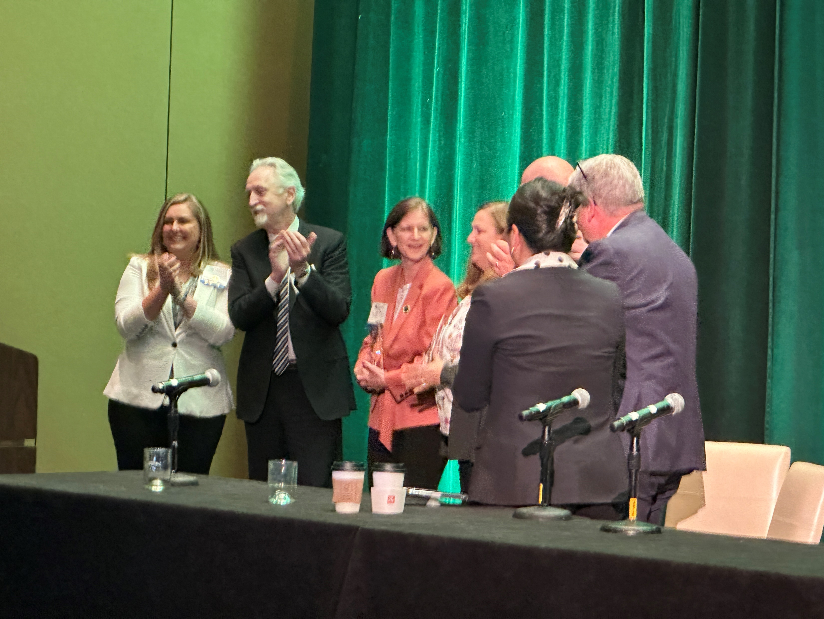
Inaugural Award

Slide 10
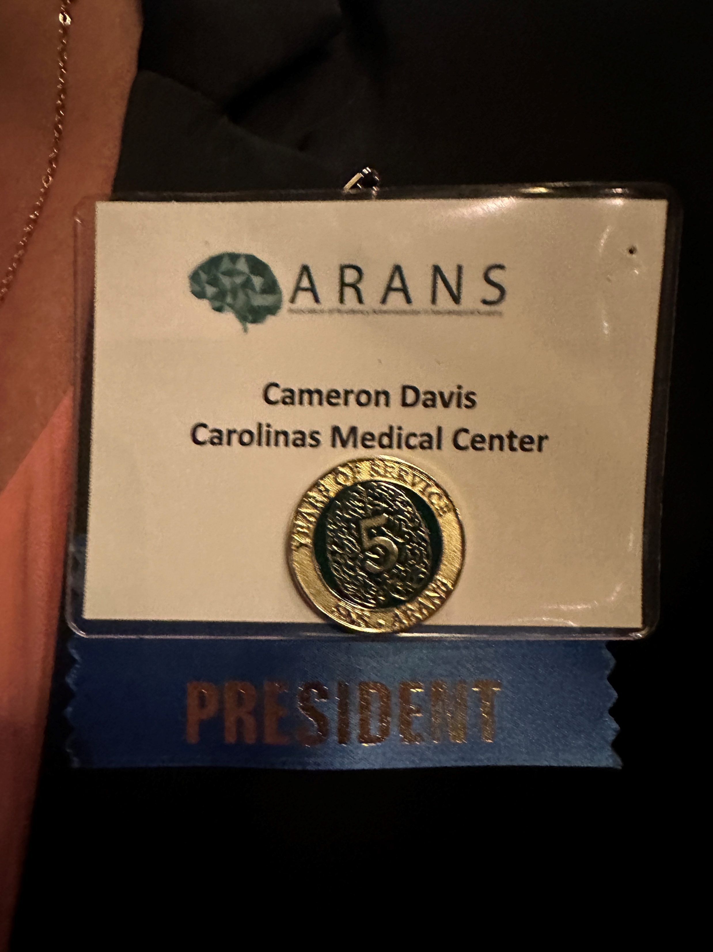
Length of Service Awards

Slide 11
One Future
Our work together is intertwined
Our organizations are tightly linked by people and by mission
We share one set of values and goals
To improve the outcomes of neurosurgical training
and, thus, to enhance human health

