Slide 1



Slide 2
WELCOME TO THE 17TH ANNUAL ARANS MEETING
CLEVELAND CLINIC
CLEVELAND, OHIO
MAY 15-17, 2025

Slide 3

Business Meeting
Call to Order/Welcome | Rita A. Raio
Secretary's Report | Kellie Devney
Treasurer’s Report New Member Report | Beth Battisti Tobi Cooney
Members at Large Report | Sophie White/Shanna Selsor
Meeting Chair Report | Margaret Minea
Member Liaison Report | Pam Lane/Mary Gallagher
New Business
Future Leadership Opportunities

Slide 4
Changes and Accomplishments 2024-2025
EC Recruitment for Terms May 2025 through May 2026
President:
President Elect:
Vice President:
Meeting Chair
Member-At-Large:
Samantha Phu
Margaret Minea
Shanna Selsor
Courtney Gilligan
Jose Gonzalez

Slide 5
ARANS Representation at SNS Quarterly Meetings Opportunity to present at the annual SNS Meeting Website up and running – many thanks to Sophie White, Beth Battisti and website committee members Mentorship Project Start-Up – Kathy Guzman Further opportunities being explored for subcommittee membership

Slide 6
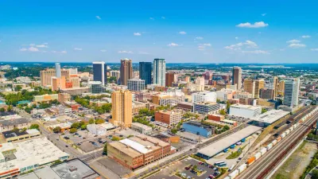
NEXT ANNUAL MEETING!!
University of Alabama
Birmingham
May 14-16, 2026

Slide 7

Secretary’s Report
Kellie Devney, C-TAGME
Secretary, ARANS

Slide 8
174 individuals (program/fellowship administrators, assistants, program managers)
Increase from 162 in 2024
25 new program administrators for 2024-2025

Slide 9
Upcoming Position Votes for 2026
President Elect (2026-2027)
Vice President (2026-2027)
Treasurer (2026-2028)
Member-At-Large (2026-2028)
Professional Organization Liaison (2026-2029)

Slide 10
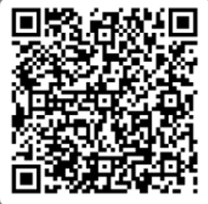
ARANS Committee Interest Form
Committees Available:
Website Committee
Annual Meeting Committee
Communications Committee
If you are interested in joining a committee, please use the QR form below and provide your contact information:

Slide 11
Treasurer’s Report
Beth Battisti, MHA, C-TAGME
Treasurer, ARANS

Slide 12
Annual Meeting Proft/Loss Statement
YEAR | LOCATION | PROFIT/LOSS
2014 | Rochester, MN | $9,404
2015 | Miami, FL | ($3,236)
2016 | Indianapolis, In | $9,875
2017 | Houston, TX | $12,359
2018 | Hershey, PA | $6,483
2019 | Seattle, WA | $4,494
2020 | Virtual Meeting | $0.00
2021 | Austin, TX | $8,831
2022 | Detroit, MI | $242
2023 | Dallas, TX | $1,424
2024 | New York NY | $2,741

Slide 13
New York Meeting Overview
Total Revenue= $43,985
74 meeting attendees

Slide 14
New York Meeting Expense Overview
Total Meeting expenses | $41,243.97
Total Meeting Revenue | $43,985
Profit | $2,741.03

Slide 15
New York Meeting Expense Overview
Cornell
Catering Expenses(lunch, breaks) | $4,570.00** ( Breakfast & service fees waived)
Room Rental | $2,100.00
Opening Reception | $6,765.20
Audiovisual | $1,775
Carmines- ARANS/SNS Dinner | $14,205.48
Transportation | $11,055.00
Speaker Gifts/Misc | $453
Total Expenses | $41,243.79

Slide 16
ARANS Financial Statement
Assets
Beginning Balance | 76,293.00
Revenues (meeting registration) | 43,985.00
Total Assets | 120,278.00
Expenses
Meeting Expenses** | 41,243.79
Website | 1,837.84
Total Expenses | 43,081.63
Ending Balance
 | 77,196.37

Slide 17
Financial Future
Financial Transparency: Increasing alignment with the SNS EC to improve clarity in accounting and budgeting.
Expense Awareness: Monitoring rising costs for venues, service fees, and other meeting expenses.
Sustainable Planning: Identifying cost-saving opportunities to support long-term financial stability.

Slide 18
New Member’s Report
Tobi Cooney, C-TAGME
New Administrator Liaison

Slide 19
Get involved – run for an EC position, serve on a committee. As people retire, we need others to serve so ARANS continues to exist.
ARANS New Member information – twice a year will meet virtually for anyone wanting to connect. Q&A format so come with questions.
I am always available via email or a phone call.
Suggestions and/or feedback are welcome.

Slide 20
Members at Large Report

Slide 21
About the Members-at-Large
Current MALs
2023-2025: Shanna Selsor; Stanford University; selsor@stanford.edu
2024-2026: Sophie White; University of Maryland; swhite@som.umaryland.edu
Role Description
Serve as a liaison to the general membership
Represent the interests of the membership

Slide 22
ARANS Website
nsadmin.org
New and improved site in progress!
Site Content
New Member Application
About ARANS
Forum
Administrator Resources
Annual Meeting Archives
New Developments
Topic-specific forums (ie available fellowships, resident courses, etc)
Regularly updated announcements
Resources and professional development content
More…

Slide 23
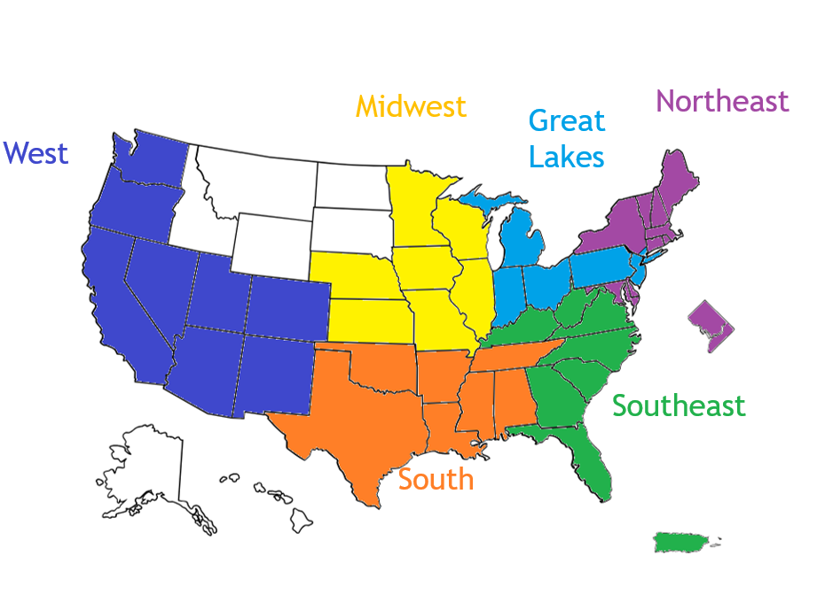
Regional Groups
West: Shannon Winchester
Midwest: Laura Walker
Great Lakes (North): Beth Battisti
Northeast: Courtney Gilligan & Isabelle Schulte
Southeast: Lauren Wilson
South: Lori DePriest

Slide 24
Meeting Chair’s Report
2025
Margaret Minea Meeting Chair

Slide 25
THANK YOU!

Slide 26



We are HERE!!!
Here we are today!
Cleveland, Ohio
Hosted by
Cleveland Clinic
May 15-17, 2025
We are so glad you are here!
Let’s learn & have some fun!!!

Slide 27
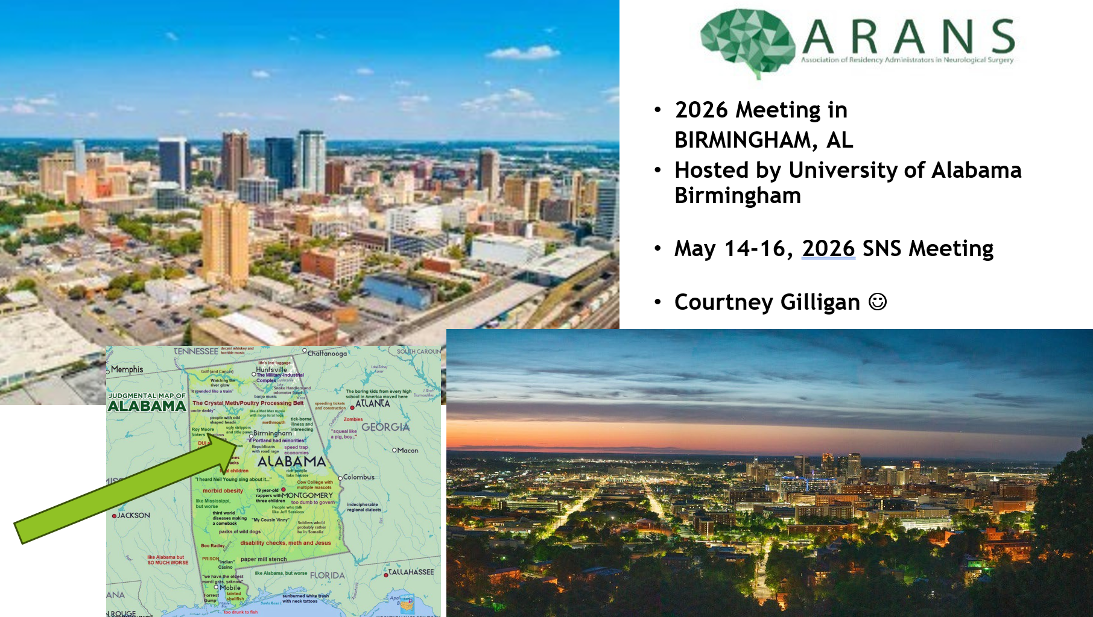

Slide 28
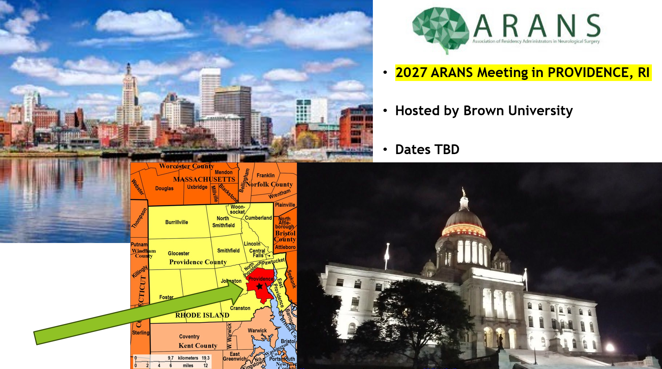

Slide 29
Professional Organization Liaisons
Mary Gallagher, Indiana University Pam Lane, Vanderbilt University
SNS/ CAST/ ABNS ACGME/ CNS/ ERAS-AAMC/ AANS
Two active members of ARANS to be selected by the Executive Council and serve staggered 3-year terms.
Responsible for regular communication with all major neurosurgery and graduate medical education
organizations. Attend ARANS Executive Committee meetings, as non-voting members, to provide updates
on policies/procedures/changes to then be disseminated to ARANS members through the ARANS Secretary.

Slide 30
Recruiting Message from
Dr. Lola Chambless
ERAS will have new neurosurgery-specific prompts
Personal statement prompt, 3 new short answer questions
All programs are opted IN to preference signaling
Applicants must be advised to signal home/away programs if interested
Looks for updated SNS guidelines in June
Make sure your students, MS 1-4, are signed up for communications from SNS
Make sure you use the correct timing for interview offers, and you must have a spot for everyone who gets an offer!

Slide 31
AANS
(American Association of Neurological Surgeons)
Complimentary membership for new 2025 incoming neurosurgery residents and neurosurgery clinical fellows. Resources and benefits include:
Reduced registration rates at AANS Annual Scientific Meetings
Discounted online education in NeuroU
Complimentary online subscription to the Journal of Neurosurgery, Journal of Neurosurgery: Pediatrics, and Journal of Neurosurgery: Spine.
Email previously sent with request for new intern information due by June 27, 2025
Kim Bondarowicz
kbondarowicz@aans.org

Slide 32
CNS
(Congress of Neurological Surgeons)
SANS Subscriptions
Purchase SANS institutional subscriptions between Sep-Nov for best annual cycle.
All SANS subscriptions are valid for 1 year from the date of purchase. SANS subscriptions are not renewable therefore programs will have to buy a new one each year.
SANS questions are automatically reset with the purchase of a new one so the system will not allow residents to pick up where they left off. They will have to start over with a blank slate of questions.
SANS Challenge Qualifying Exam
Opens May 1 through June 2
Top 12 qualifying teams will participate in the competition at the CNS annual meeting

Slide 33
CNS Updates
New Resident Accounts
The CNS Membership Team will be sending out notifications sometime in July to all Administrators regarding setting up accounts for incoming PGY1s.
CNS accounts can only be created by a CNS staff person. Creating an account through the CNS website on your own only offers basic non-member access to our website. Non-member accounts will not link to things like SANS subscriptions or discounted products.
membership@cns.org with any questions regarding this.

Slide 34
CNS Updates
Complimentary Resident Housing at the CNS Annual Meeting
Available to a limited number of CNS Resident members and International Resident members on a first-come, first-served basis.
To be considered for this program, members must register for the CNS Annual Meeting and select that they are interested in Resident Housing. Residents must be registered by June 30, 2024 to be considered. A CNS Staff member will reach out for further instructions.
CNS Resident Committee
Ivette Hernandez is a good resource for additional updates happening with this committee. They have established a new application process for residents to join this committee which she can provide more info on. Her email is ihernandez@cns.org

Slide 35
CNS Updates
Artificial Intelligence in Neurosurgery-May 31 (virtual)
Great course for residents interested in data science

Slide 36


Slide 37
THANK YOU!

Slide 38
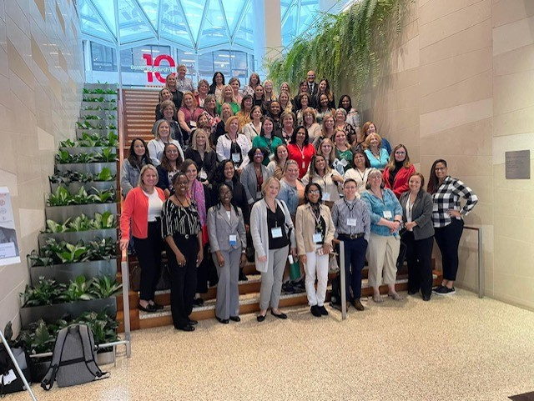

Slide 39


Ann Bowman
University of Louisville
Karena Love
University of Texas Southwestern Medical Center
Katie Roche
Massachusetts General Hospital
Meredith Suescun
University of Texas HSC at Houston
Sophie White
University of Maryland

Slide 40

Avis Foster
University of Illinois - Chicago
Britnee Daniels
University of Texas Southwestern Medical Center
Margaret Minea
University of Kansas

Slide 41

Angeles Delgado-Skerret
Icahn School of Medicine at Mount Sinai
Roselee Rego
Brown University/Rhode Island Hospital

Slide 42

Lois Hengenius
CWRU SOM/University Hospitals Cleveland Medical Center

