Slide 1

Aligning Resources with Responsibility:
A Proposal for CAST Fellowship FTE Minimums
Shanna Selsor, MHS
ARANS annual meeting
May 17, 2025

Slide 2
Agenda
CAST Overview
Identify the Concern
Proposed Solutions by ARANS
Survey
Results

Slide 3


Committee on advanced subspeciality training
“CAST accredits fellowship programs that exist within a structure of an ACGME-accredited residency in neurological surgery..”
Structured learning across all programs
Appropriate case volume for the fellow and fellowship program
Program Director is certified and credentialed with an RFP

Slide 4
Cast OVERVIEW
Skull Base
Spine
Neurocritical Care
CNS Endovascular
Cerebrovascular
Neurosurgical Oncology
Peripheral Nerve
Stereotactic & Functional
Neurotrauma
INTENT: We want to ensure there is enough administrative support for the current CAST fellowships our programs have, and to support the continued growth of CAST within our own departments

Slide 5

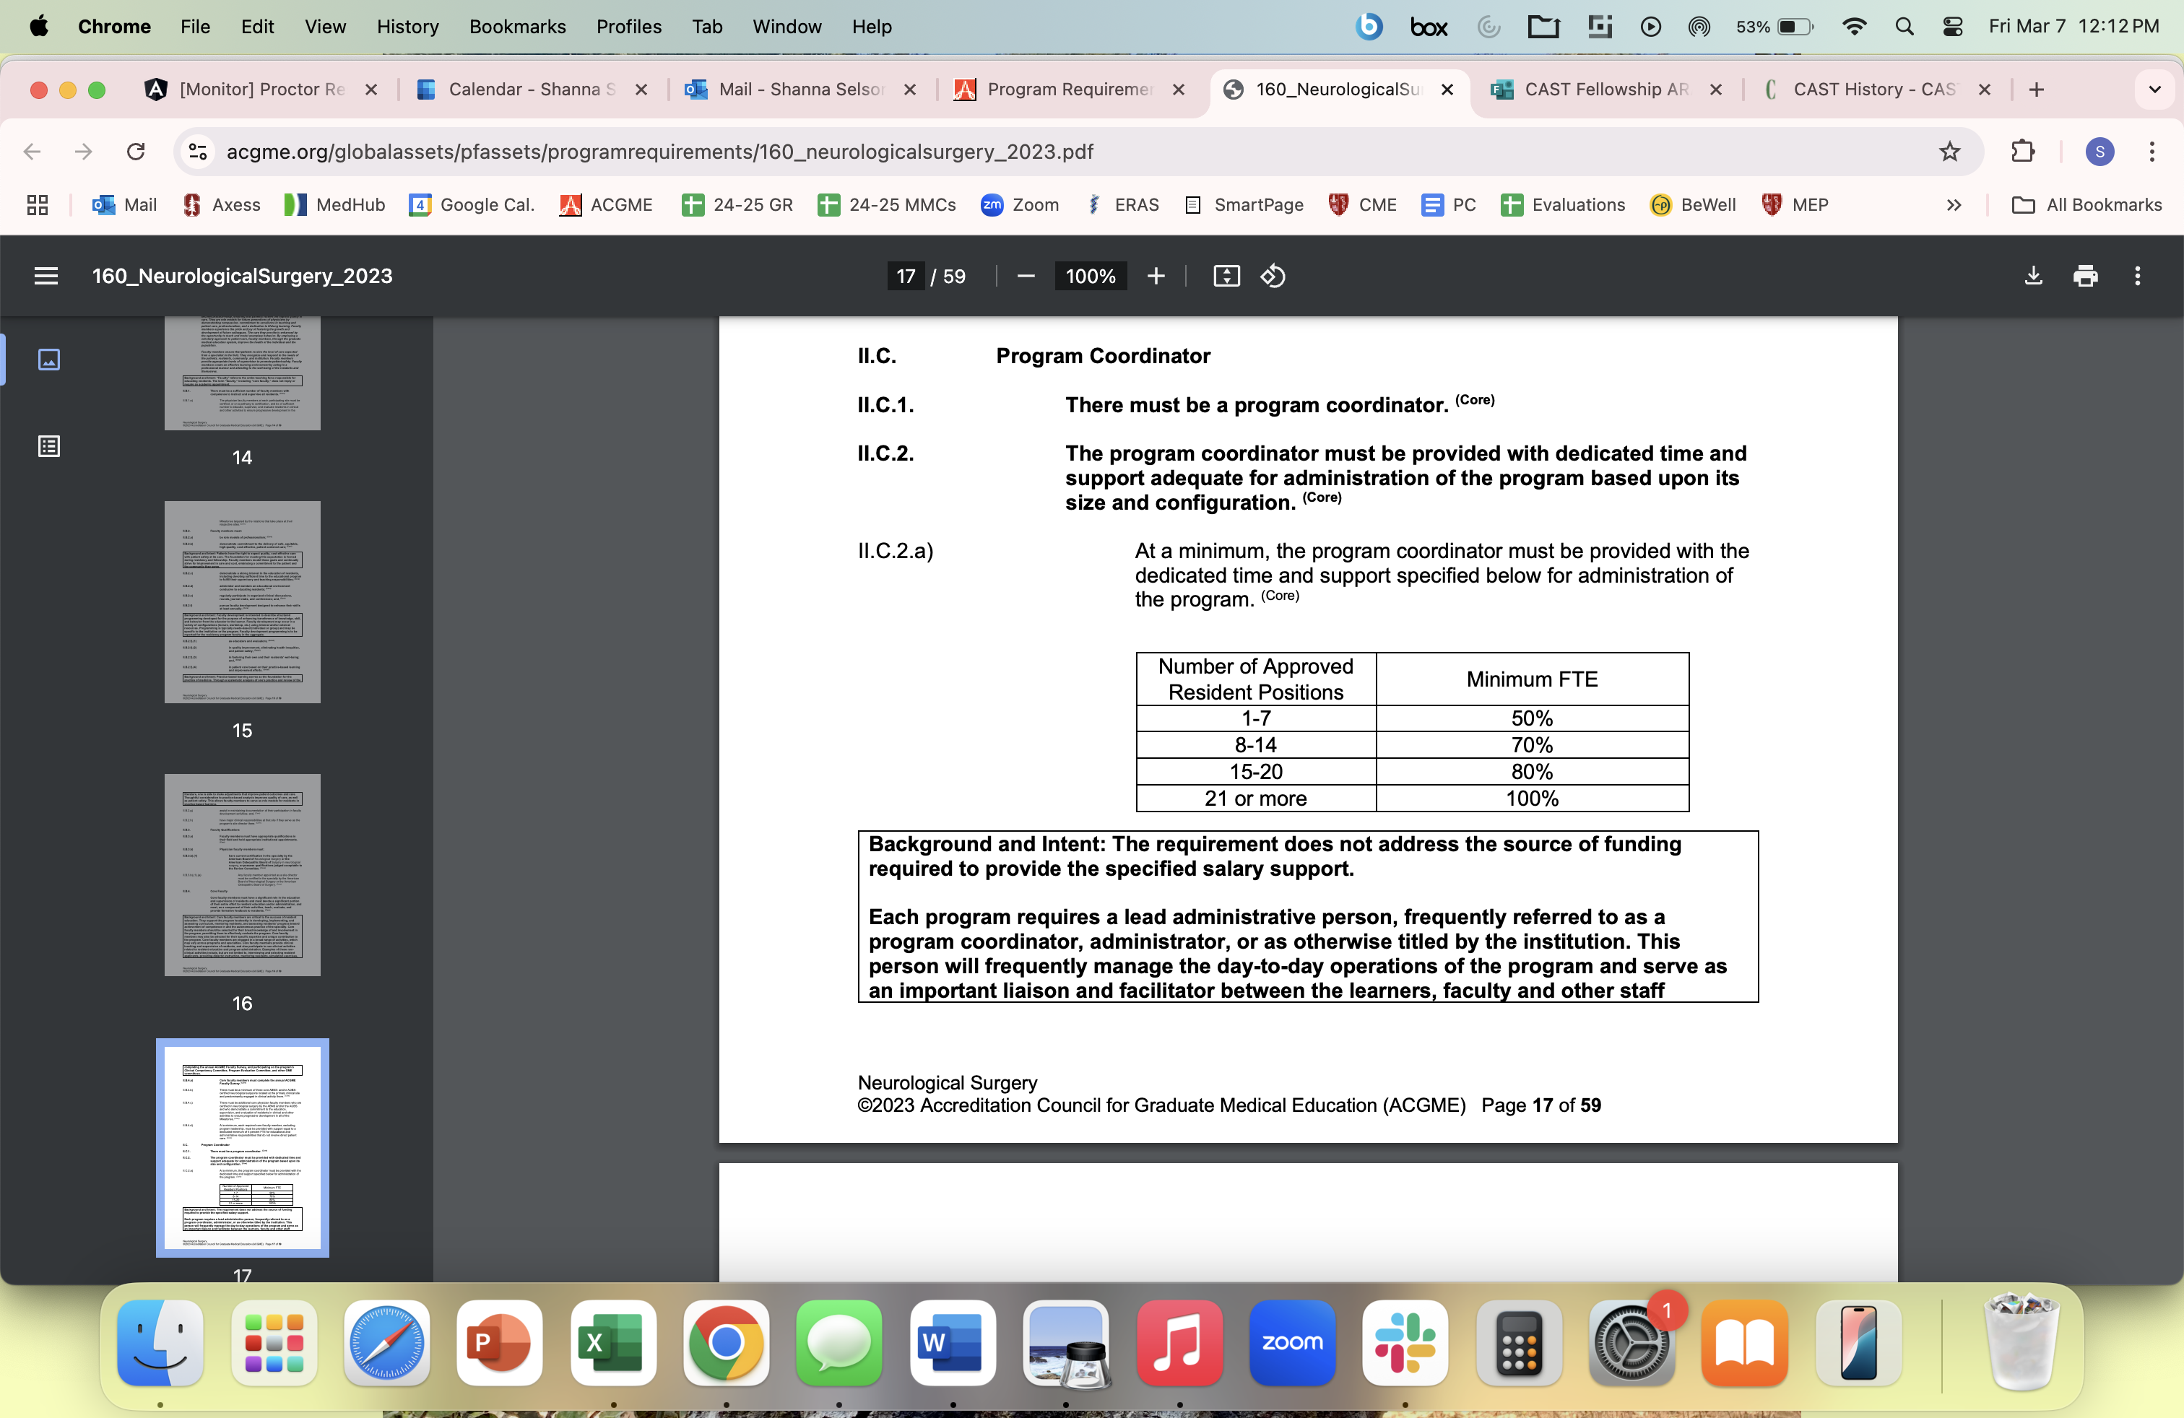
Acgme fte policy

Slide 6
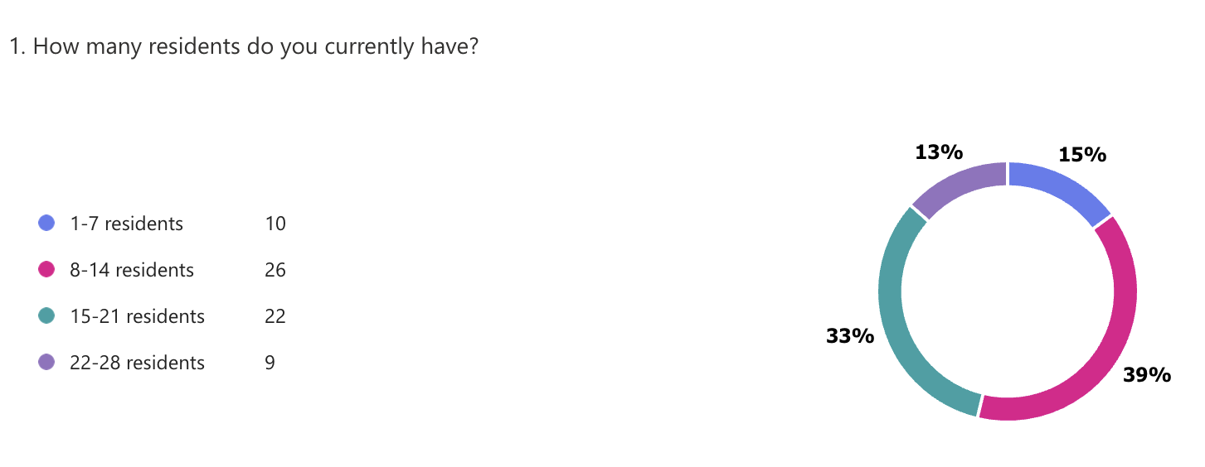
How many residents do you currently have?

Slide 7
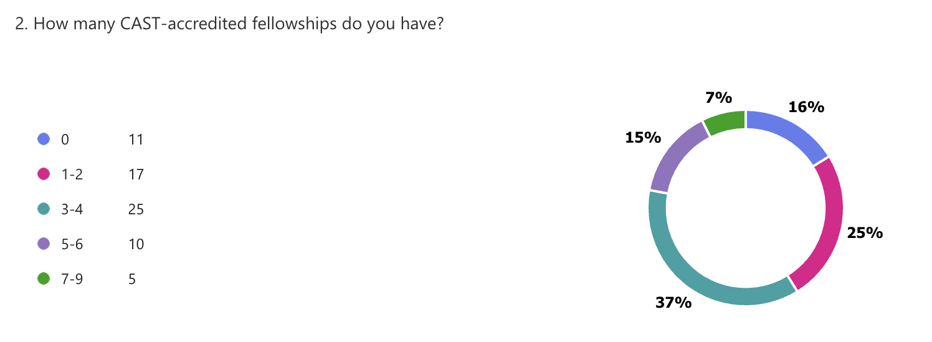
How many CAST-accredited fellowships do you have?

Slide 8
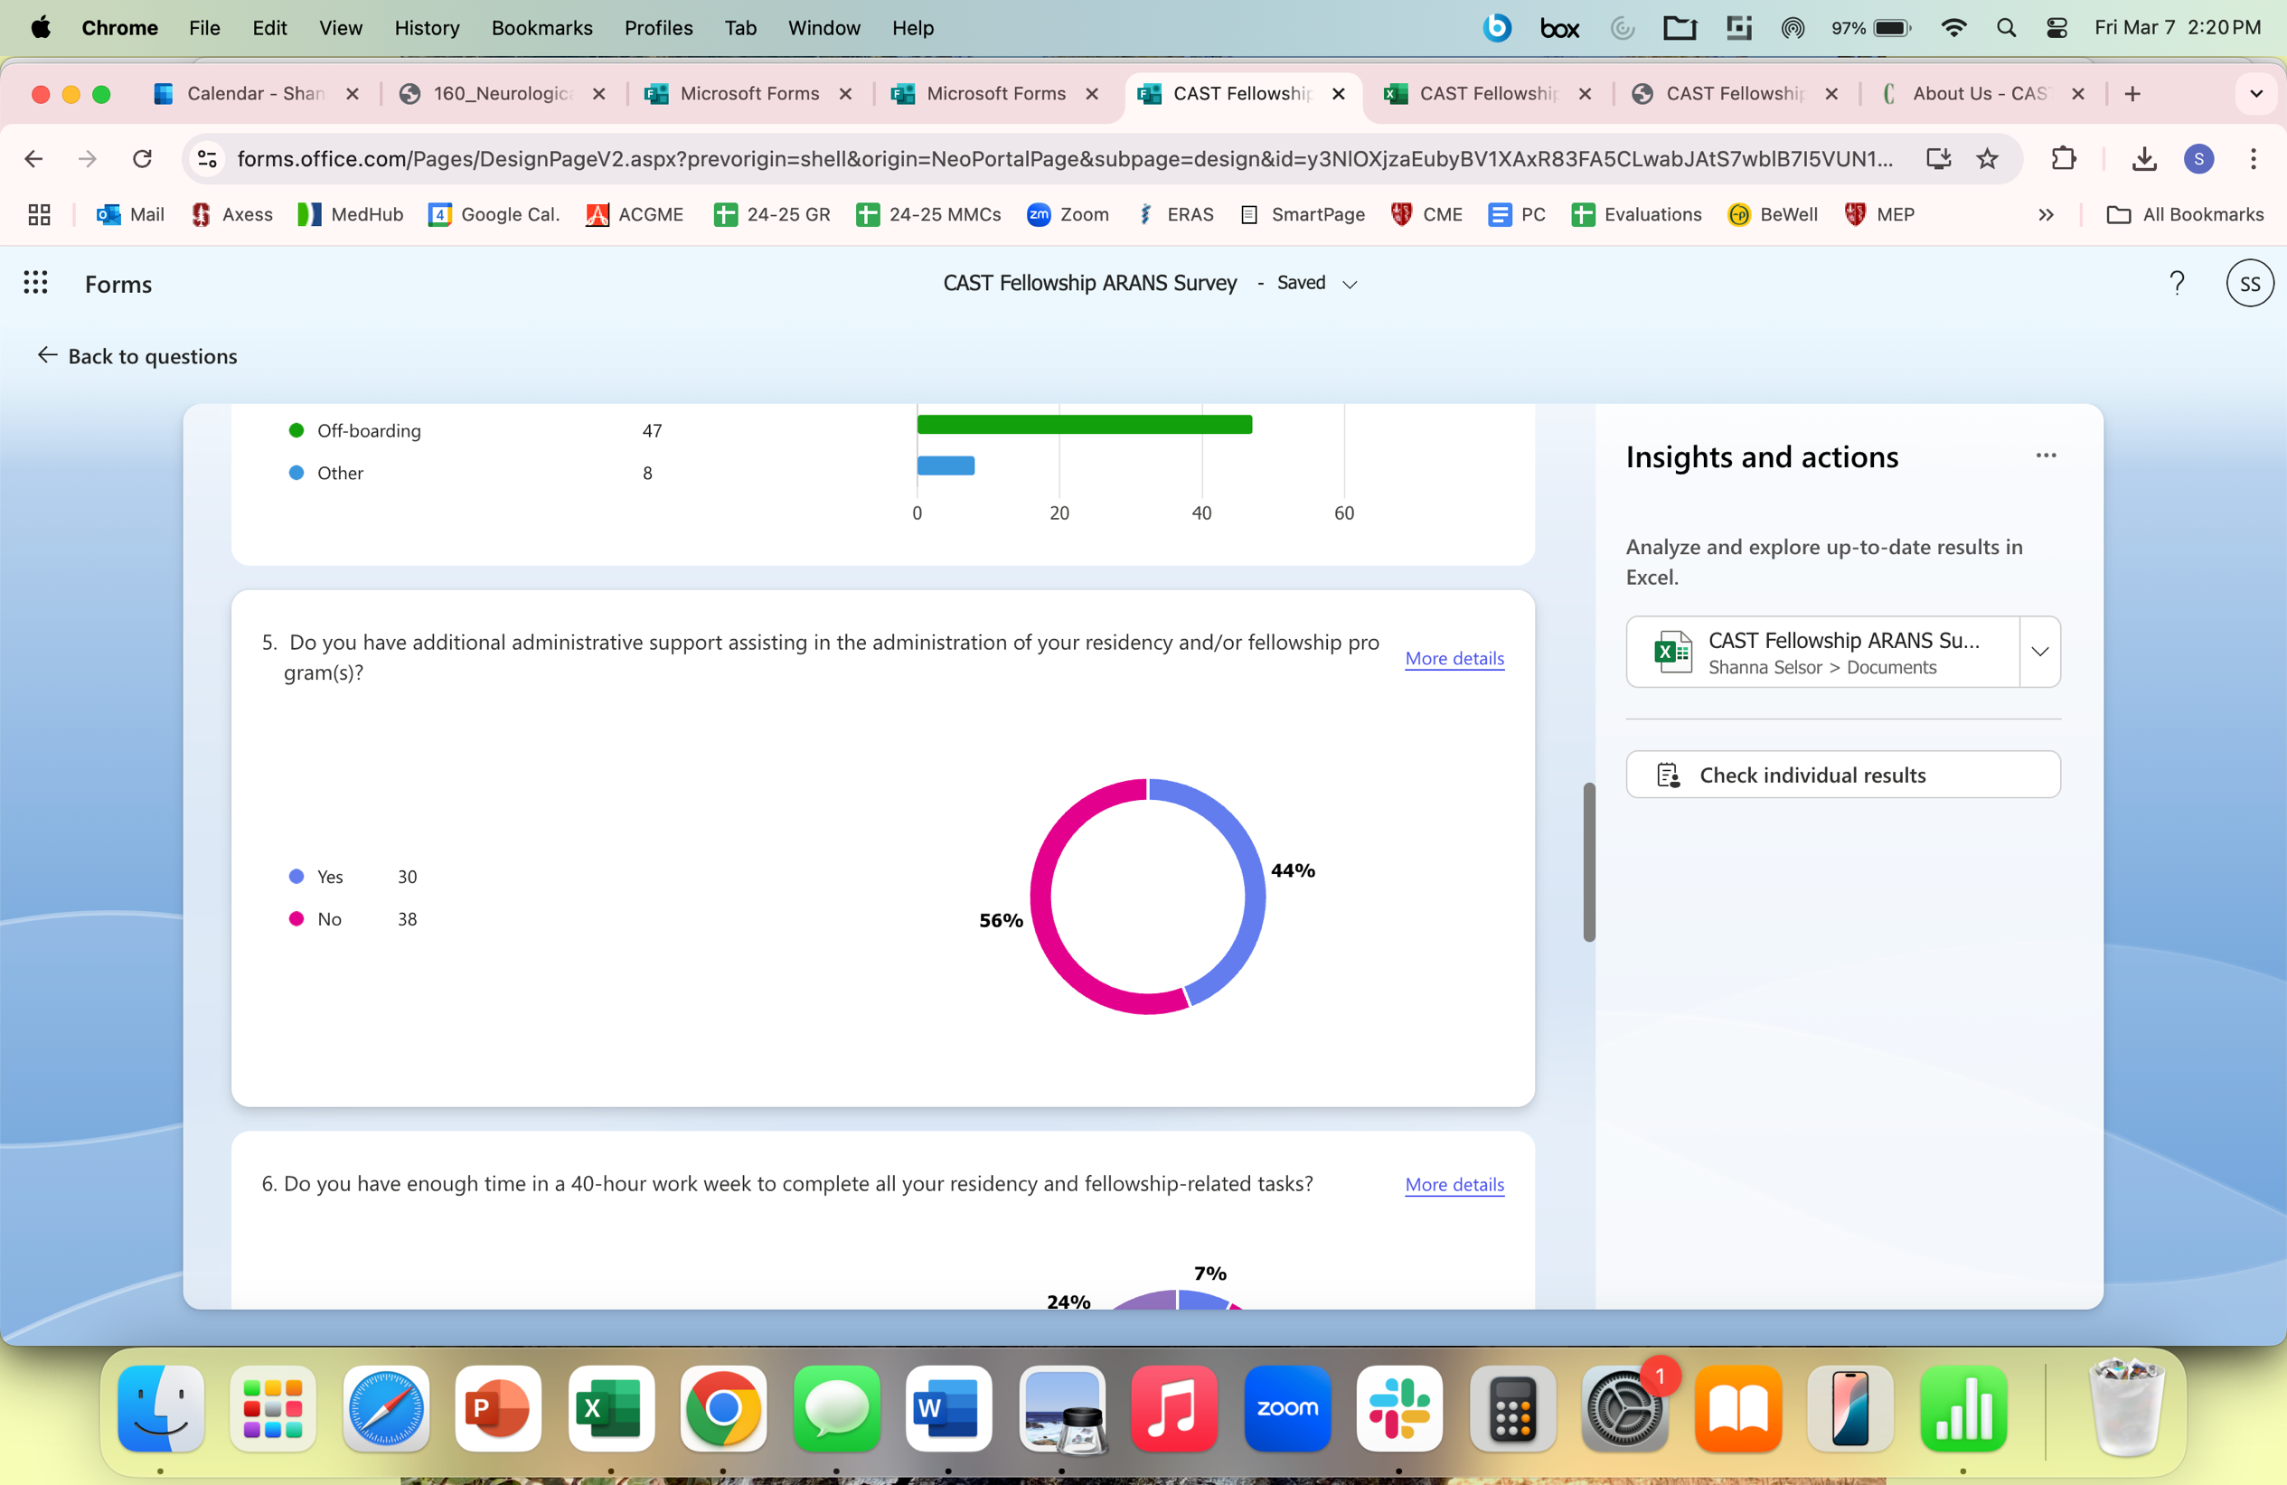
Do you have additional support in your residency and/or fellowship programs?

Slide 9
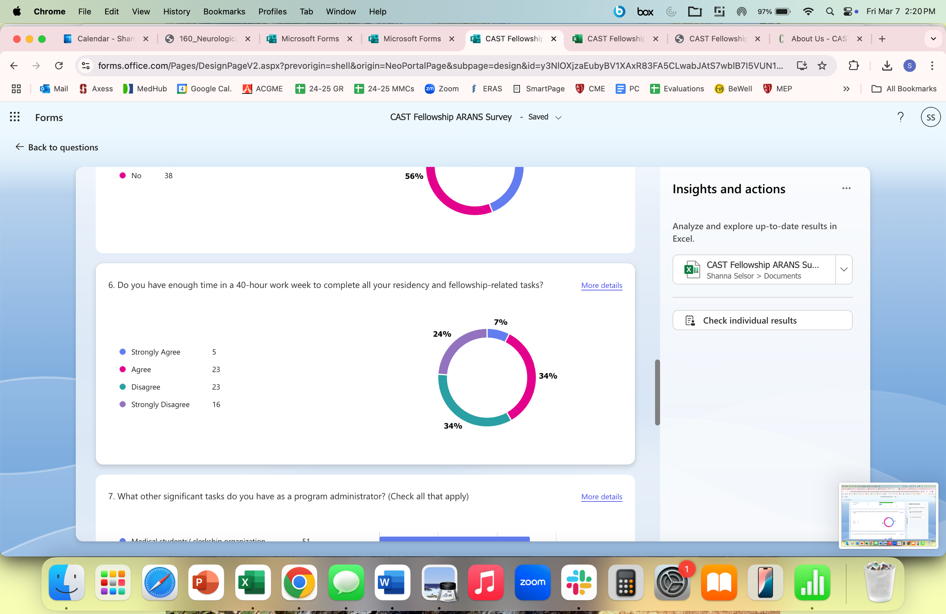
Do you have enough time to complete all your residency/ Fellowship related tasks

Slide 10
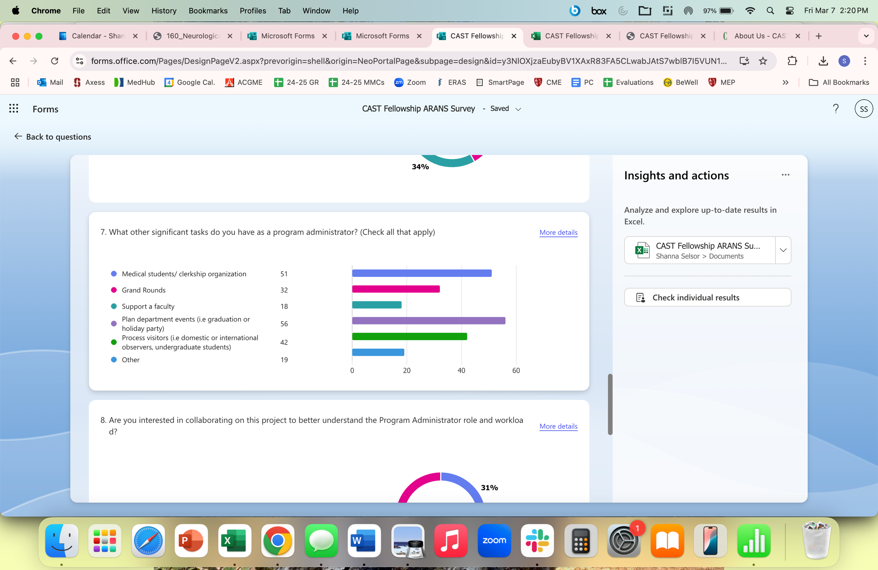
What other significant tasks do you have as a program administrator?

Slide 11
















CAST FTE Working GROUP
Rita Raio
Mary Gallagher
Shannon Winchester
Laura Walker
Christine Loscri
Katie Roche
Ashley King Long
Karena Love
Pam Lane
Carole Lavender
Cha Esguerra
Lauren Woodell
Sherolyn Patterson
Beth Battise
Colleen Bruton

Slide 12
Proposed FTE minimums for
CAST Fellowships
Additions to the Annual Report:
  Include name of Fellowship Coordinator, Residency Coordinator, number of residents, number of other CAST Fellowships
  AFI or deny applications if programs have insufficient admin support

Slide 13

“program CEREBRUM”
  21 residents
  One CAST Spine fellowship (2 fellows)
  One CAST Functional fellowship (1 fellow)
  One program administrator
Notation on the Annual Report Letter:
“The CAST office has noted the Fellowship Coordinator also supports the residency program of 21 residents and two other CAST Fellowships with additional two fellows. The Program may need to consider additional administrative support personnel.”

Slide 14

“program Dura”
  25 residents
  One CAST Spine fellowship (1 fellow)
  One NeuroIR CAST fellowship (2 fellows)
  One CAST Skull Base fellowship (1 fellow)
  One program administrator
Notation on the Annual Report Letter:
“The CAST office has noted a concern in insufficient program administrative support personnel. Per the FTE requirements set by CAST and ACGME, the Program is not compliant and must address this concern in the next annual report. Failure to address may result in probation or removal of accreditation.

Slide 15
Proposed FTE minimums for
CAST Fellowships
Additions to the Annual Report:
  Include name of Fellowship Coordinator, Residency Coordinator, number of residents, number of other CAST Fellowships
  AFI or deny applications if programs have insufficient admin support

Slide 16
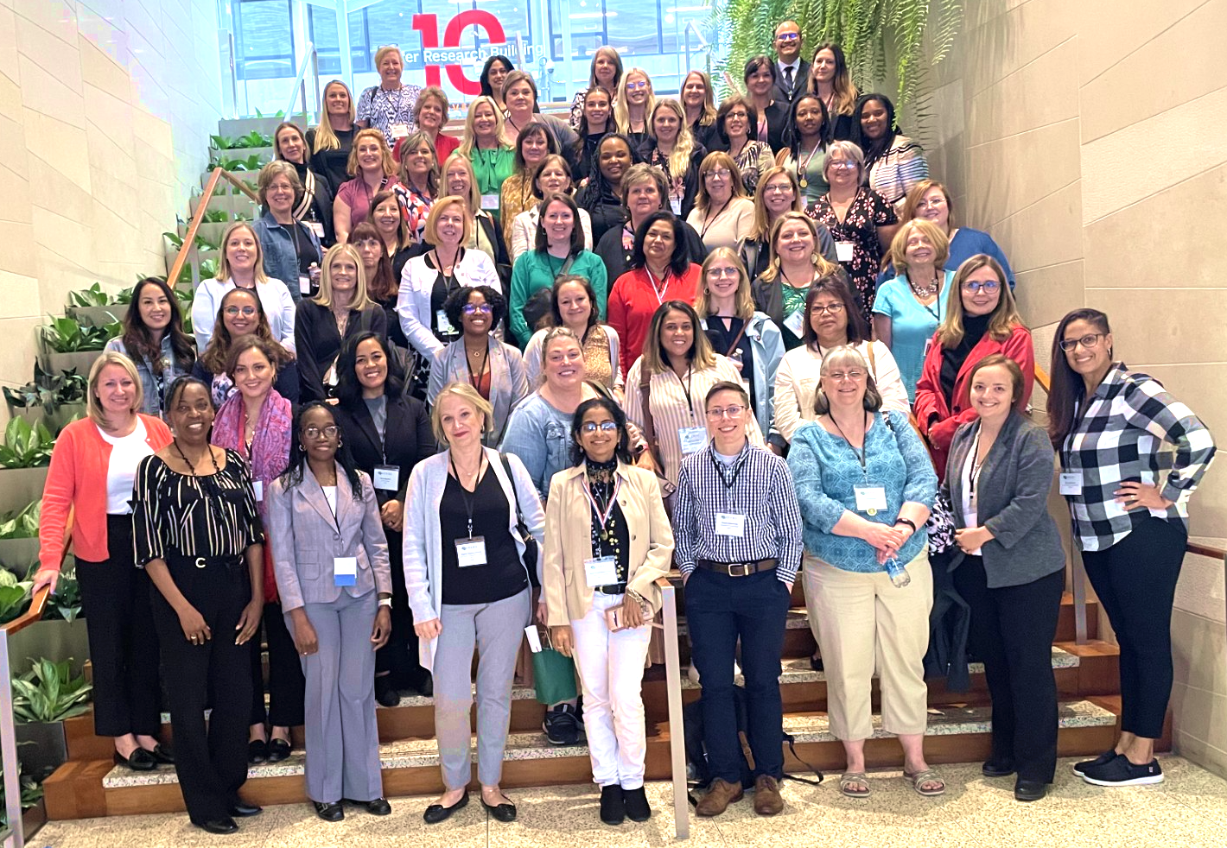
IS THERE AN ISSUE YOU
NEED HELP SOLVING?
LET’S TACKLE IT TOGETHER!

